Slide 1
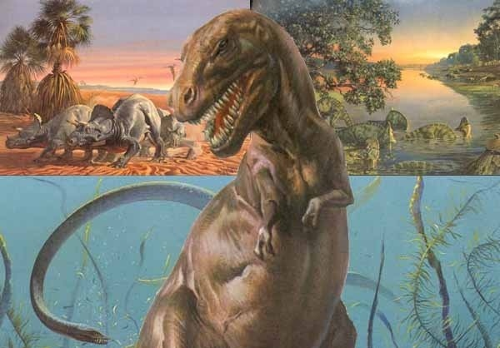
What Happened to the Dinosaurs?

Slide 2
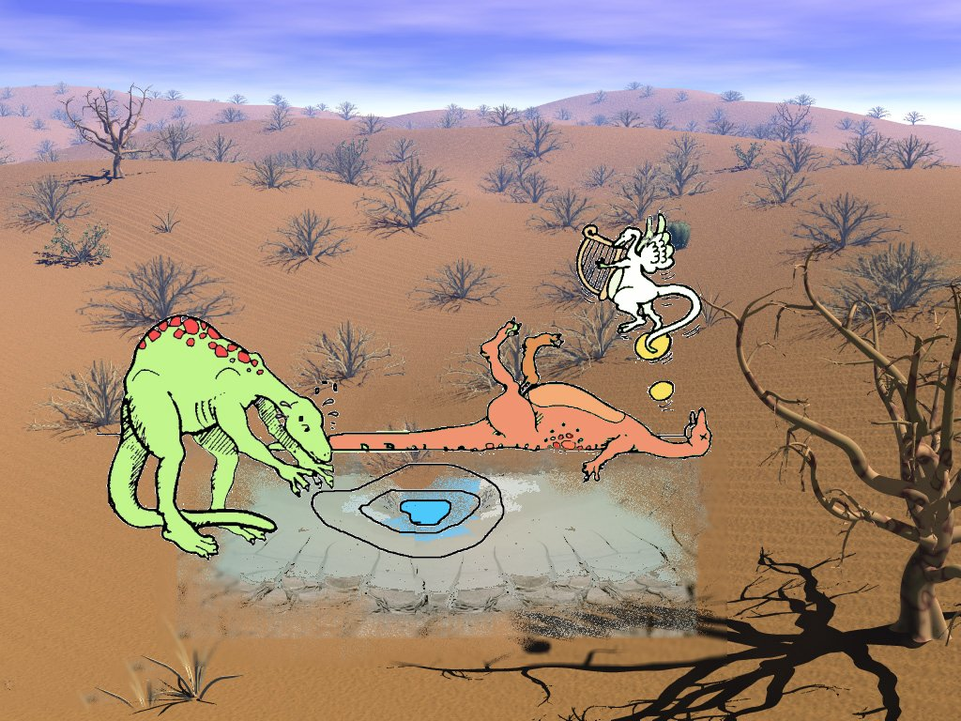
Too Hot

Slide 3
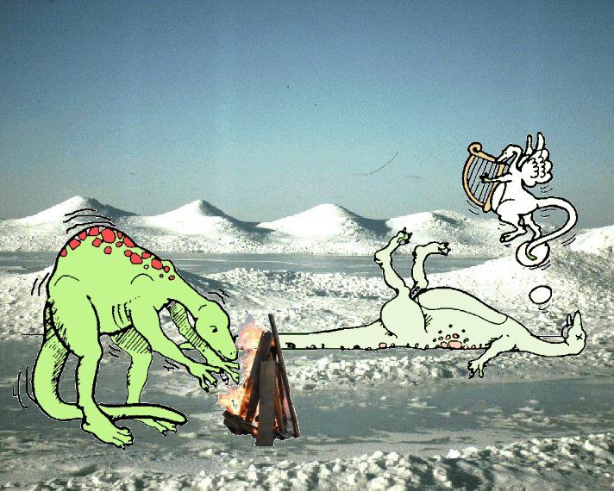
Too Cold

Slide 4
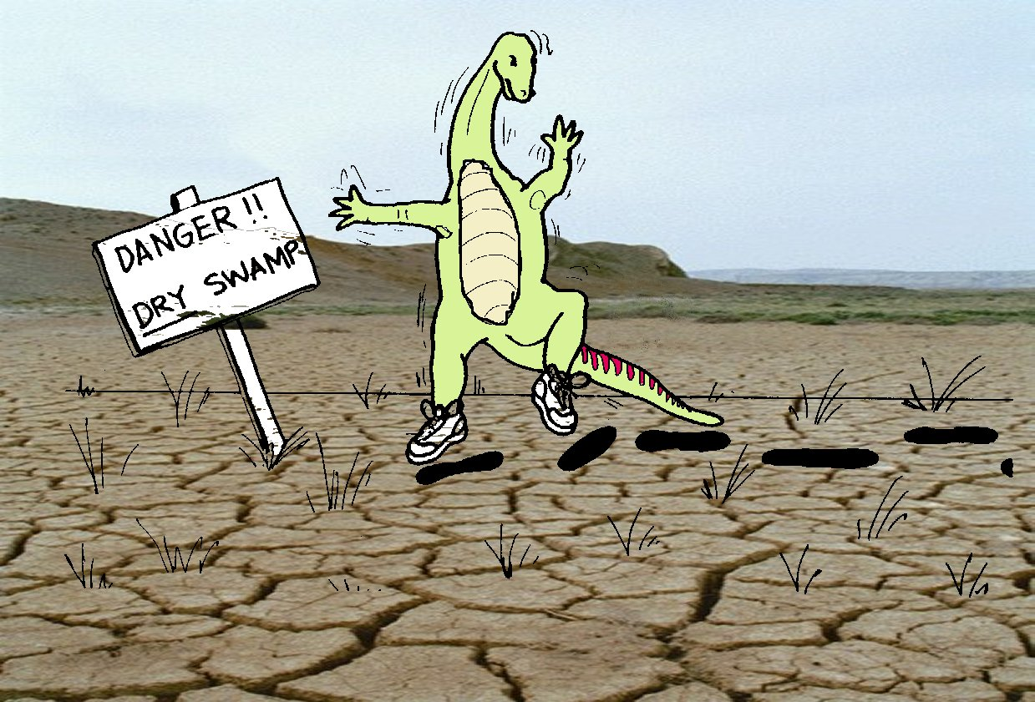
Too Dry

Slide 5
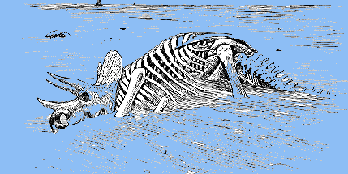
Too Wet

Slide 6
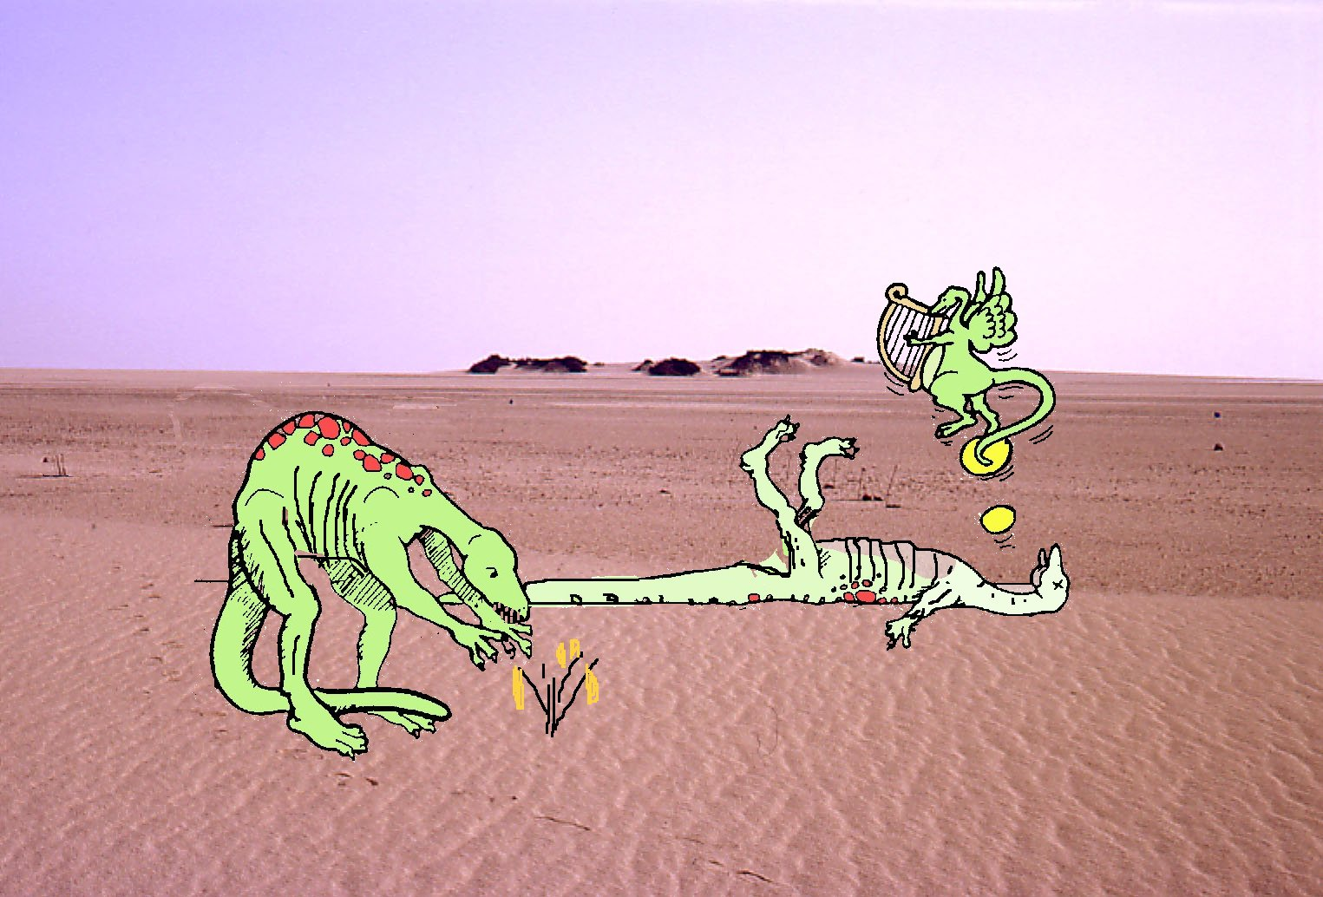
Too Little Food

Slide 7
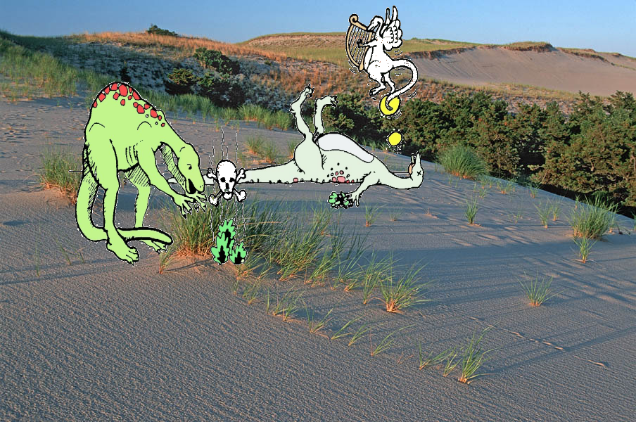
Poison Food

Slide 8
Constipated
Wait, what?!

Slide 9
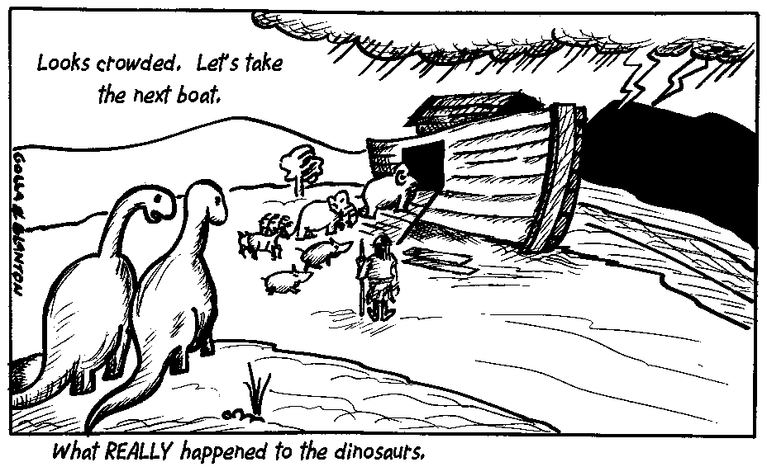
Or Maybe They Were Shy!

Slide 10
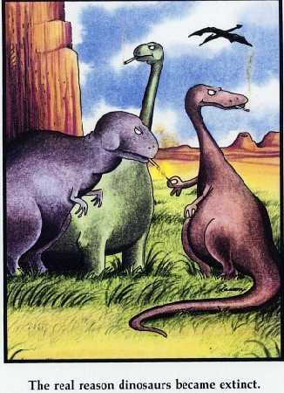
The Real Reason Dinosaurs Became Extinct

Slide 11
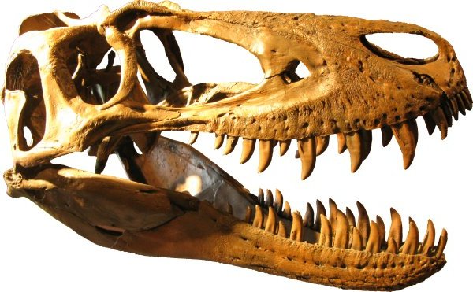
Our Project
A Taphonomic Study

Slide 12
Our Project
Started - 1996
Cooperative project sponsored by
  1. Earth History Research Center
  2. Southwestern Adventist University
  3. Hanson Research Station
  4. Support from Southern Adventist Univ.
Currently:
– June excavations in Wyoming
- July to May in Texas (SWAU) preparation, curation and analysis

Slide 13
Top of MESOZOIC

Slide 14
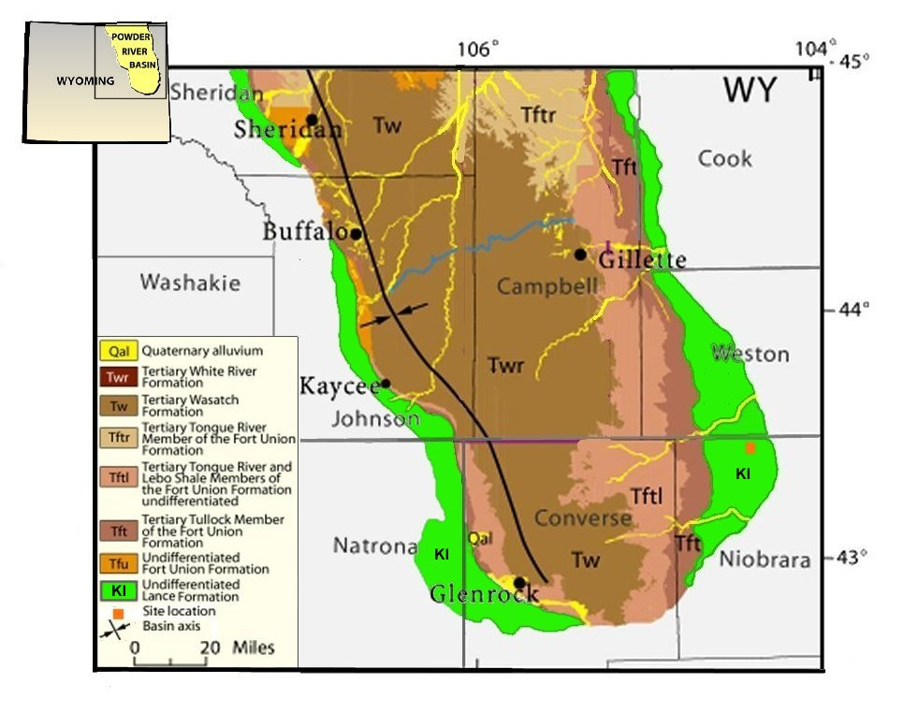
f

Slide 15
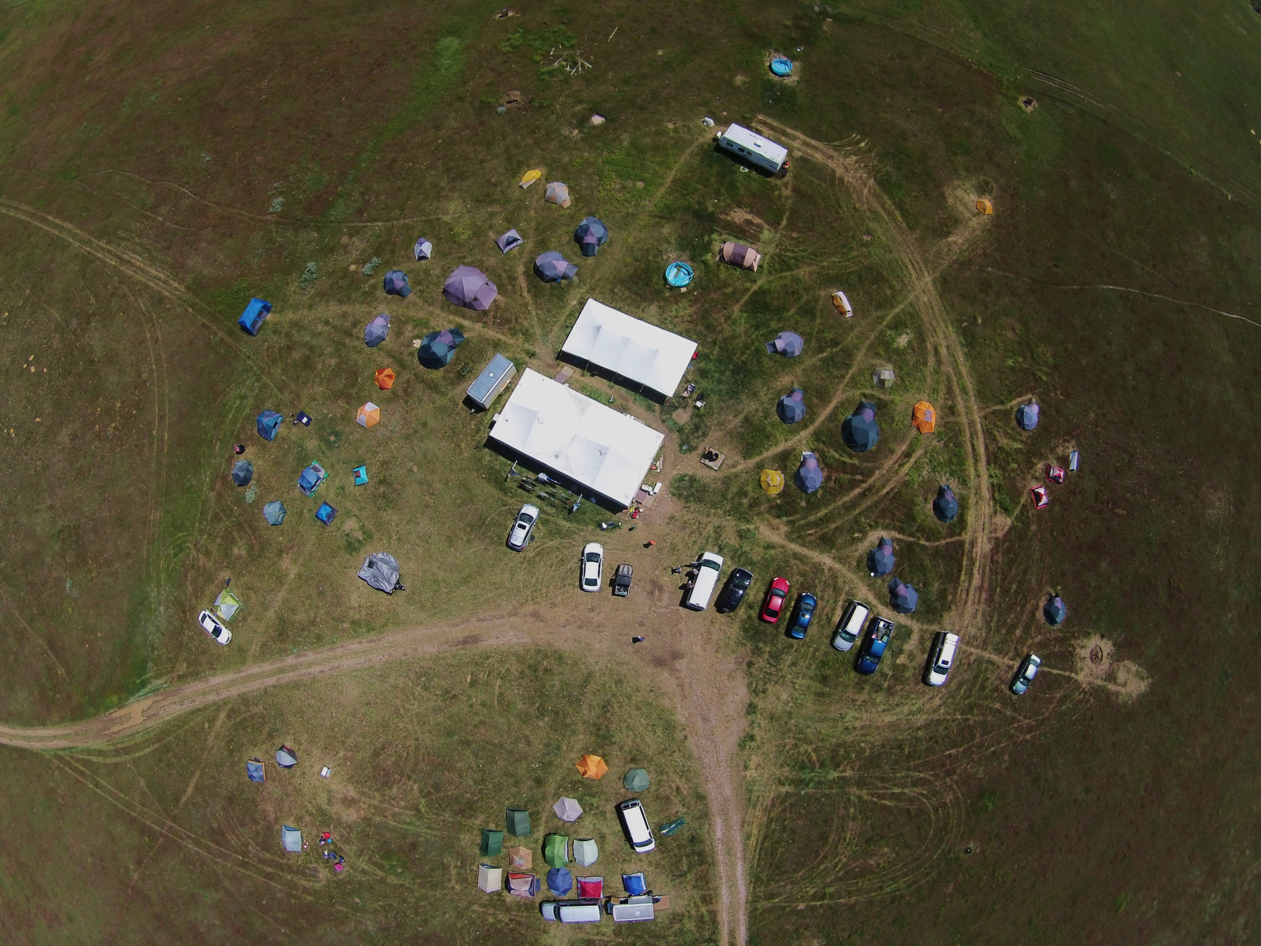
1000 Feet Up

Slide 16
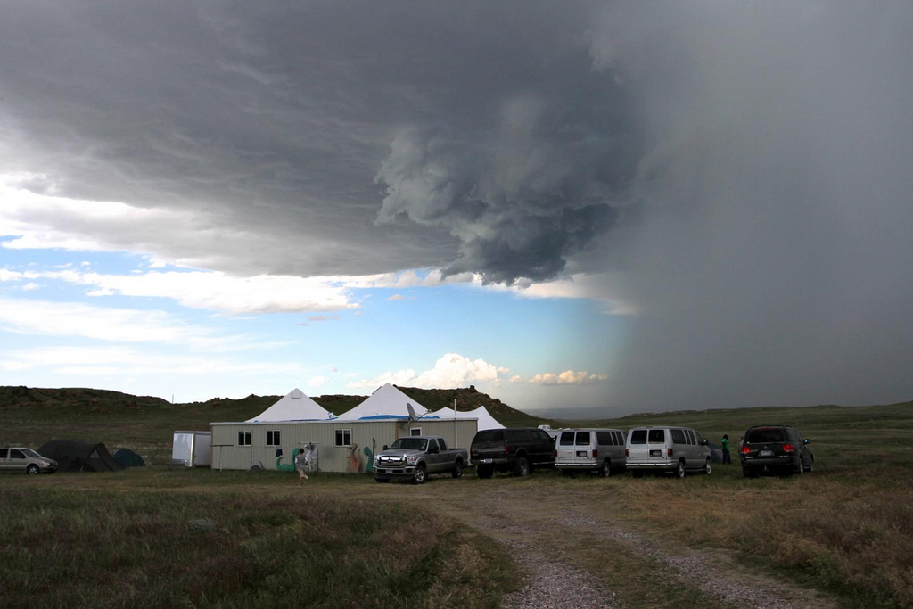

Slide 17
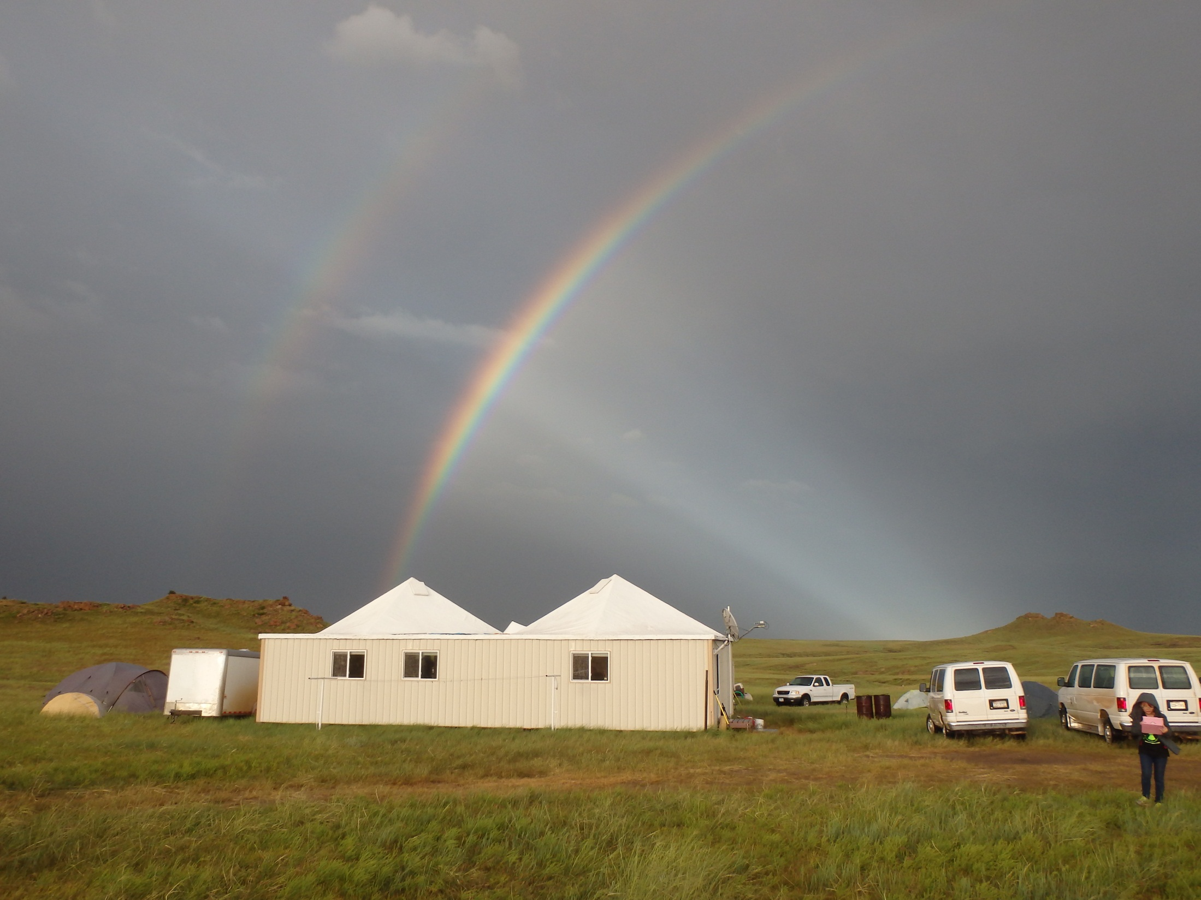

Slide 18
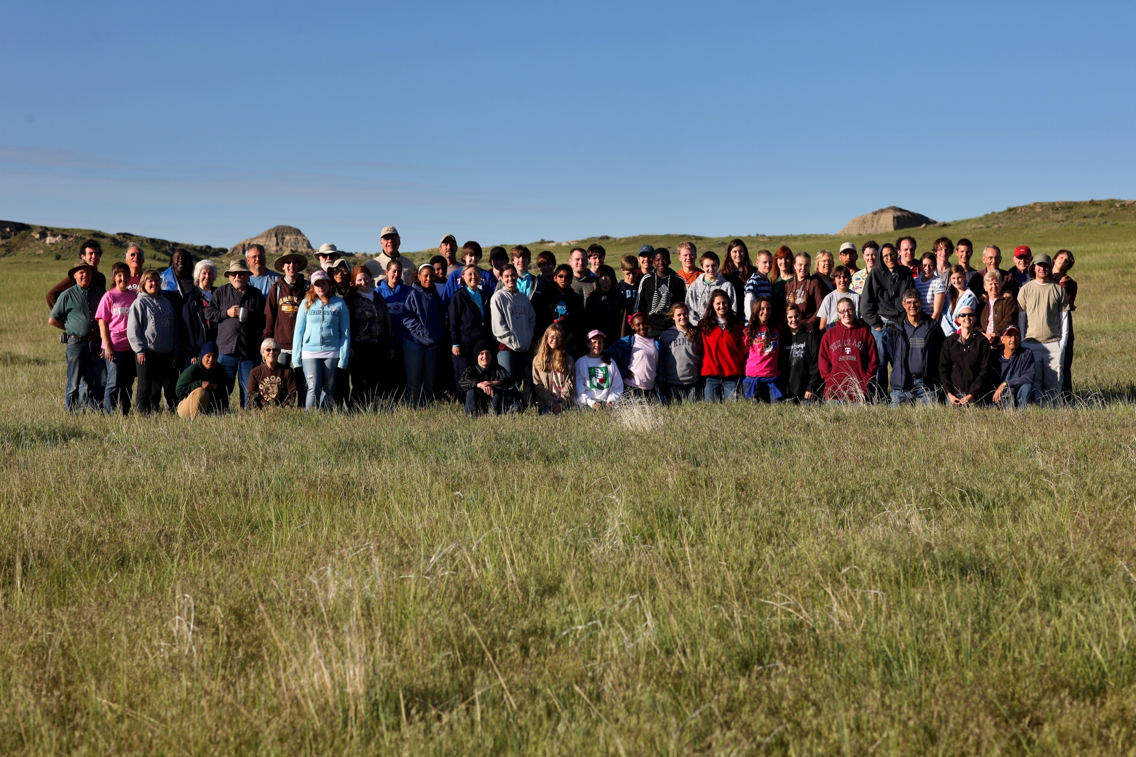
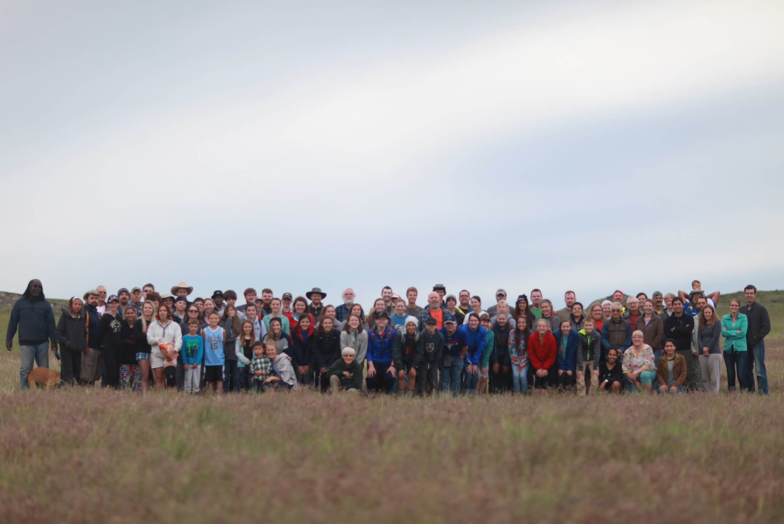
Participants

Slide 19
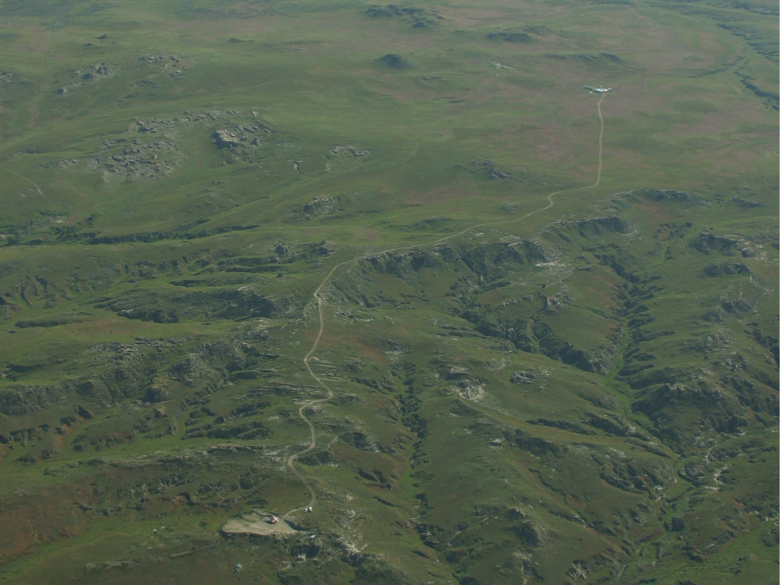
Reaching the Site

Slide 20
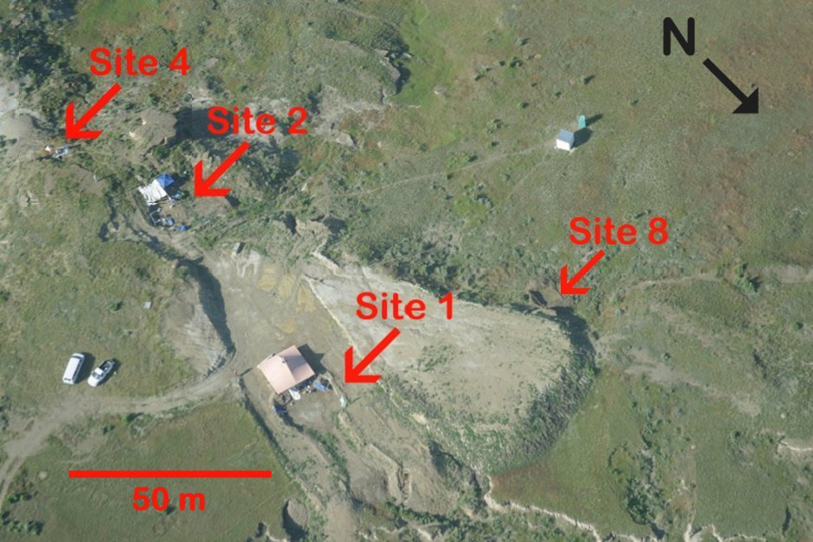
Our Work Site

Slide 21
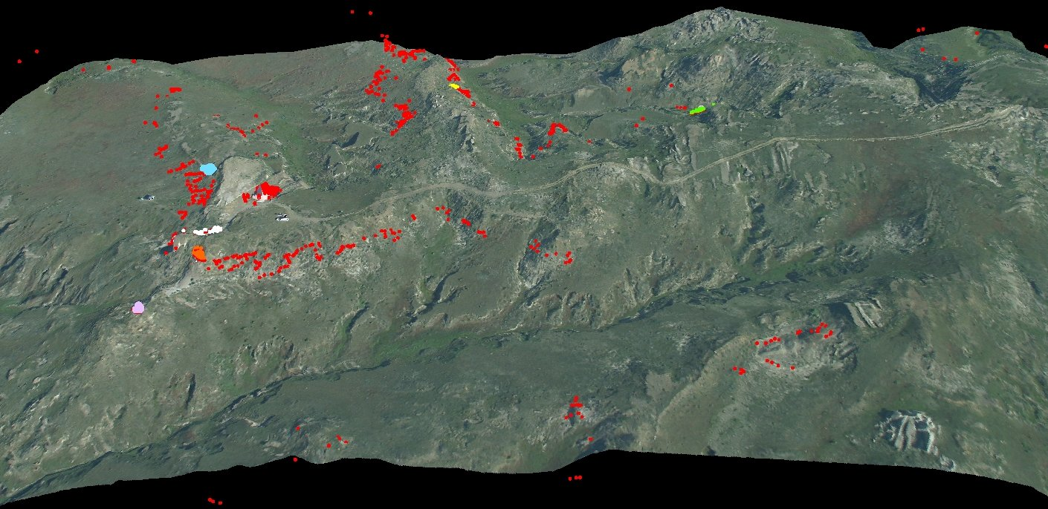
Our Bone Bed
l
New Site Opened Last Year

Slide 22
Types of Dinosaurs
Herbivores

Slide 23
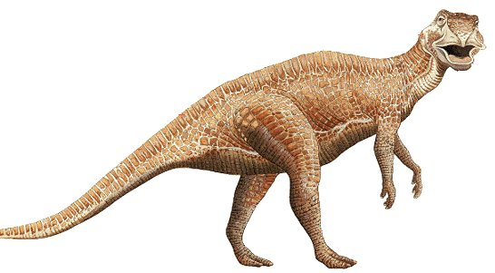
Edmontosaurus annectens

Slide 24
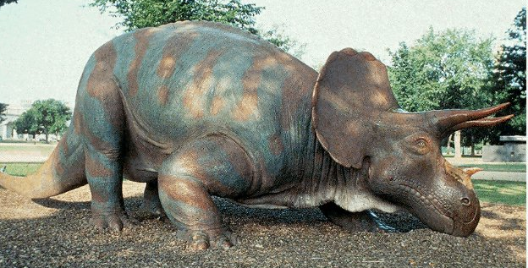
Triceratops horridus

Slide 25
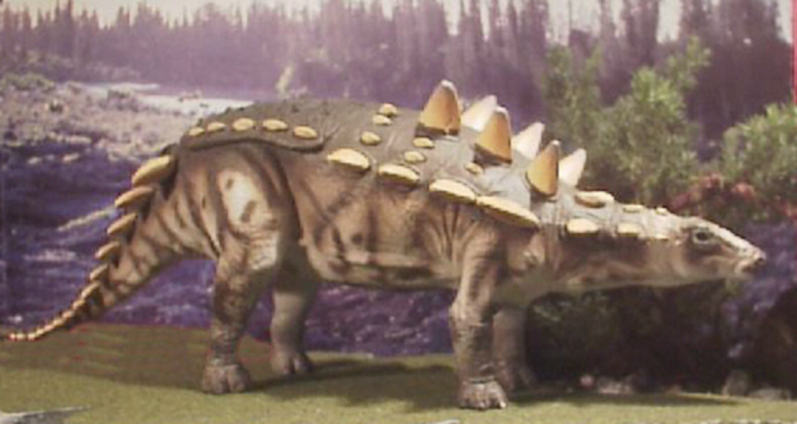

Nodosaurus
Nodosaurus

Slide 26
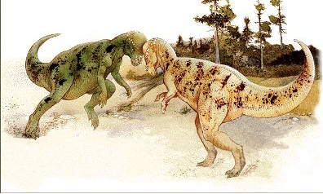
Pachycephalosaurus sp.

Slide 27
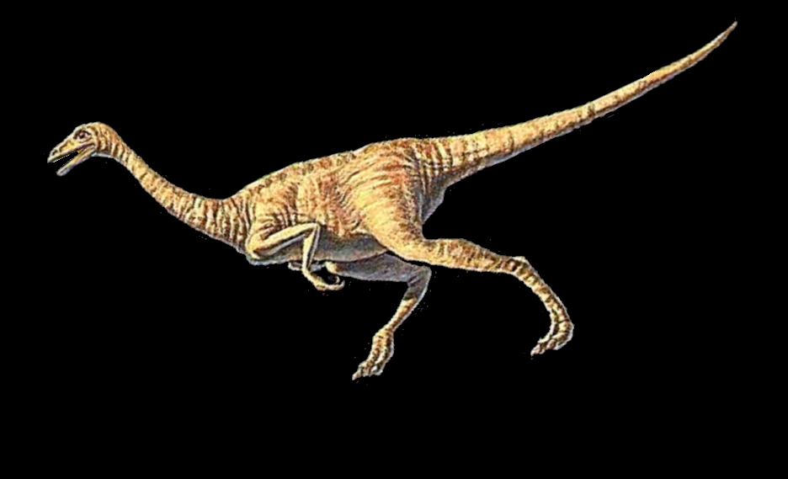
Struthiomimus sp.

Slide 28
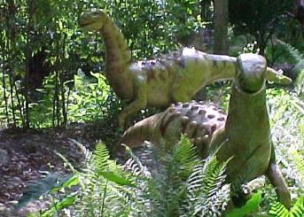
Thescelosaurus sp.

Slide 29
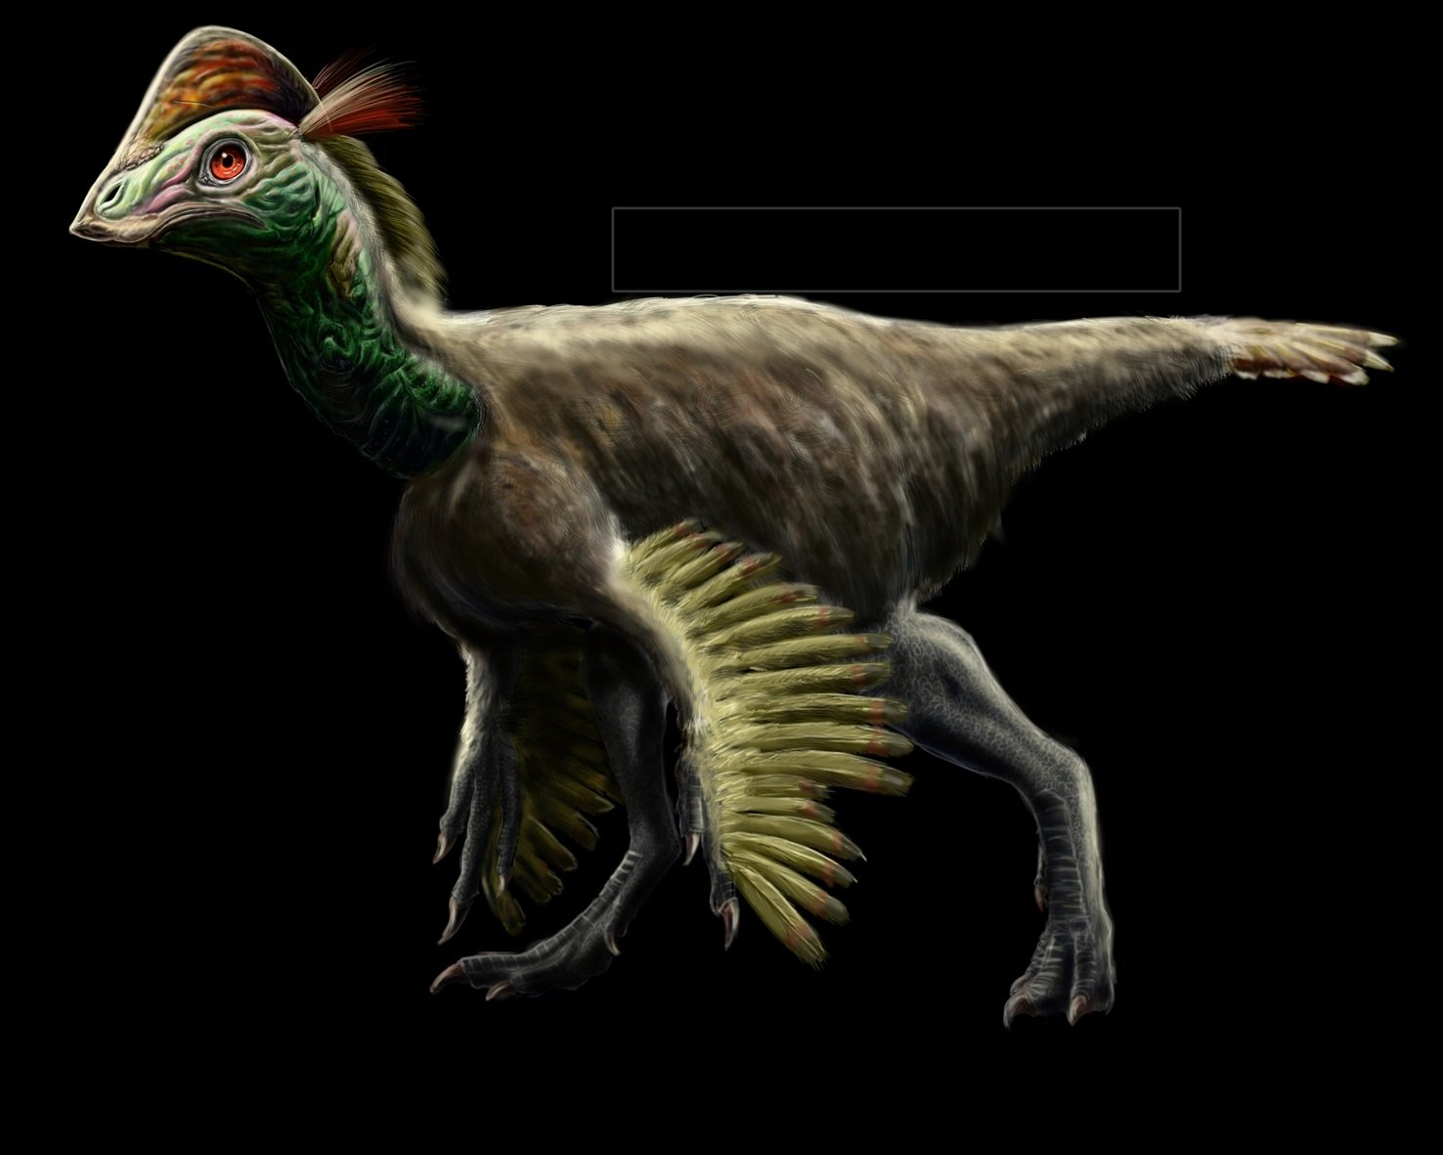
Anzu wyliei

Slide 30
Types of Dinosaurs
Carnivores

Slide 31
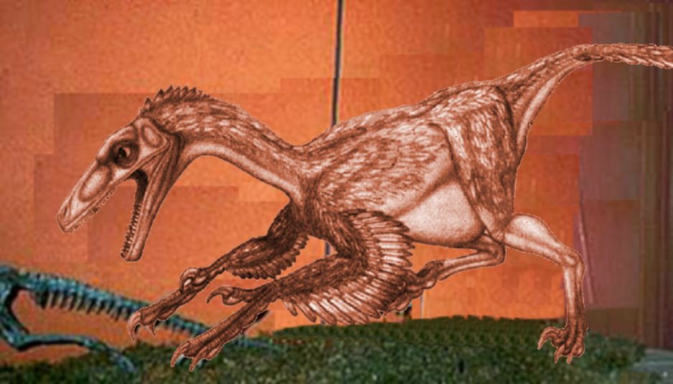
Troodon sp.
Troodon sp.

Slide 32
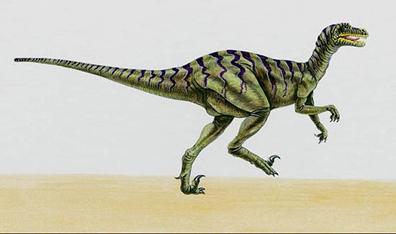
Dromaeosaurus

Slide 33
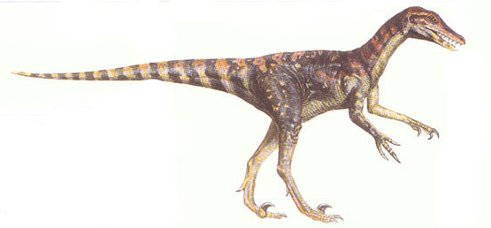
Saurornitholestes

Slide 34
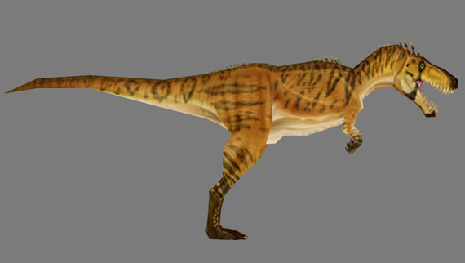
Nanotyrannus

Slide 35
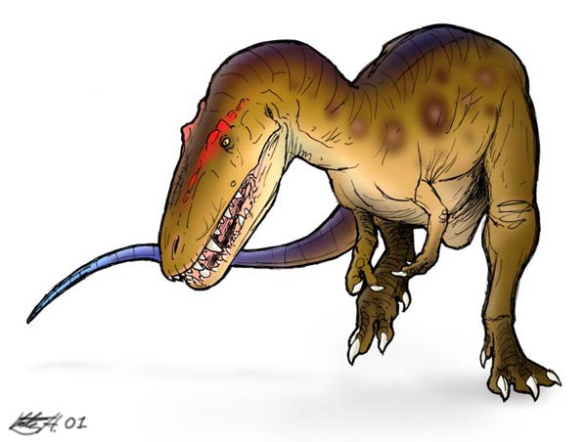
Aublysodon sp.

Slide 36
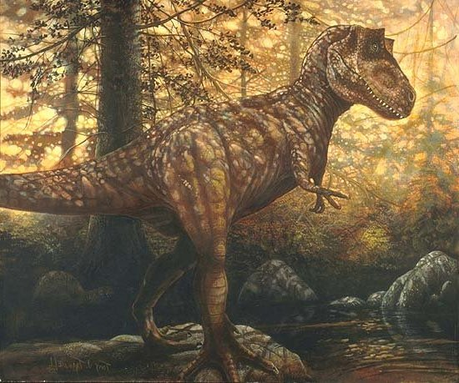
Tyrannosaurus rex

Slide 37
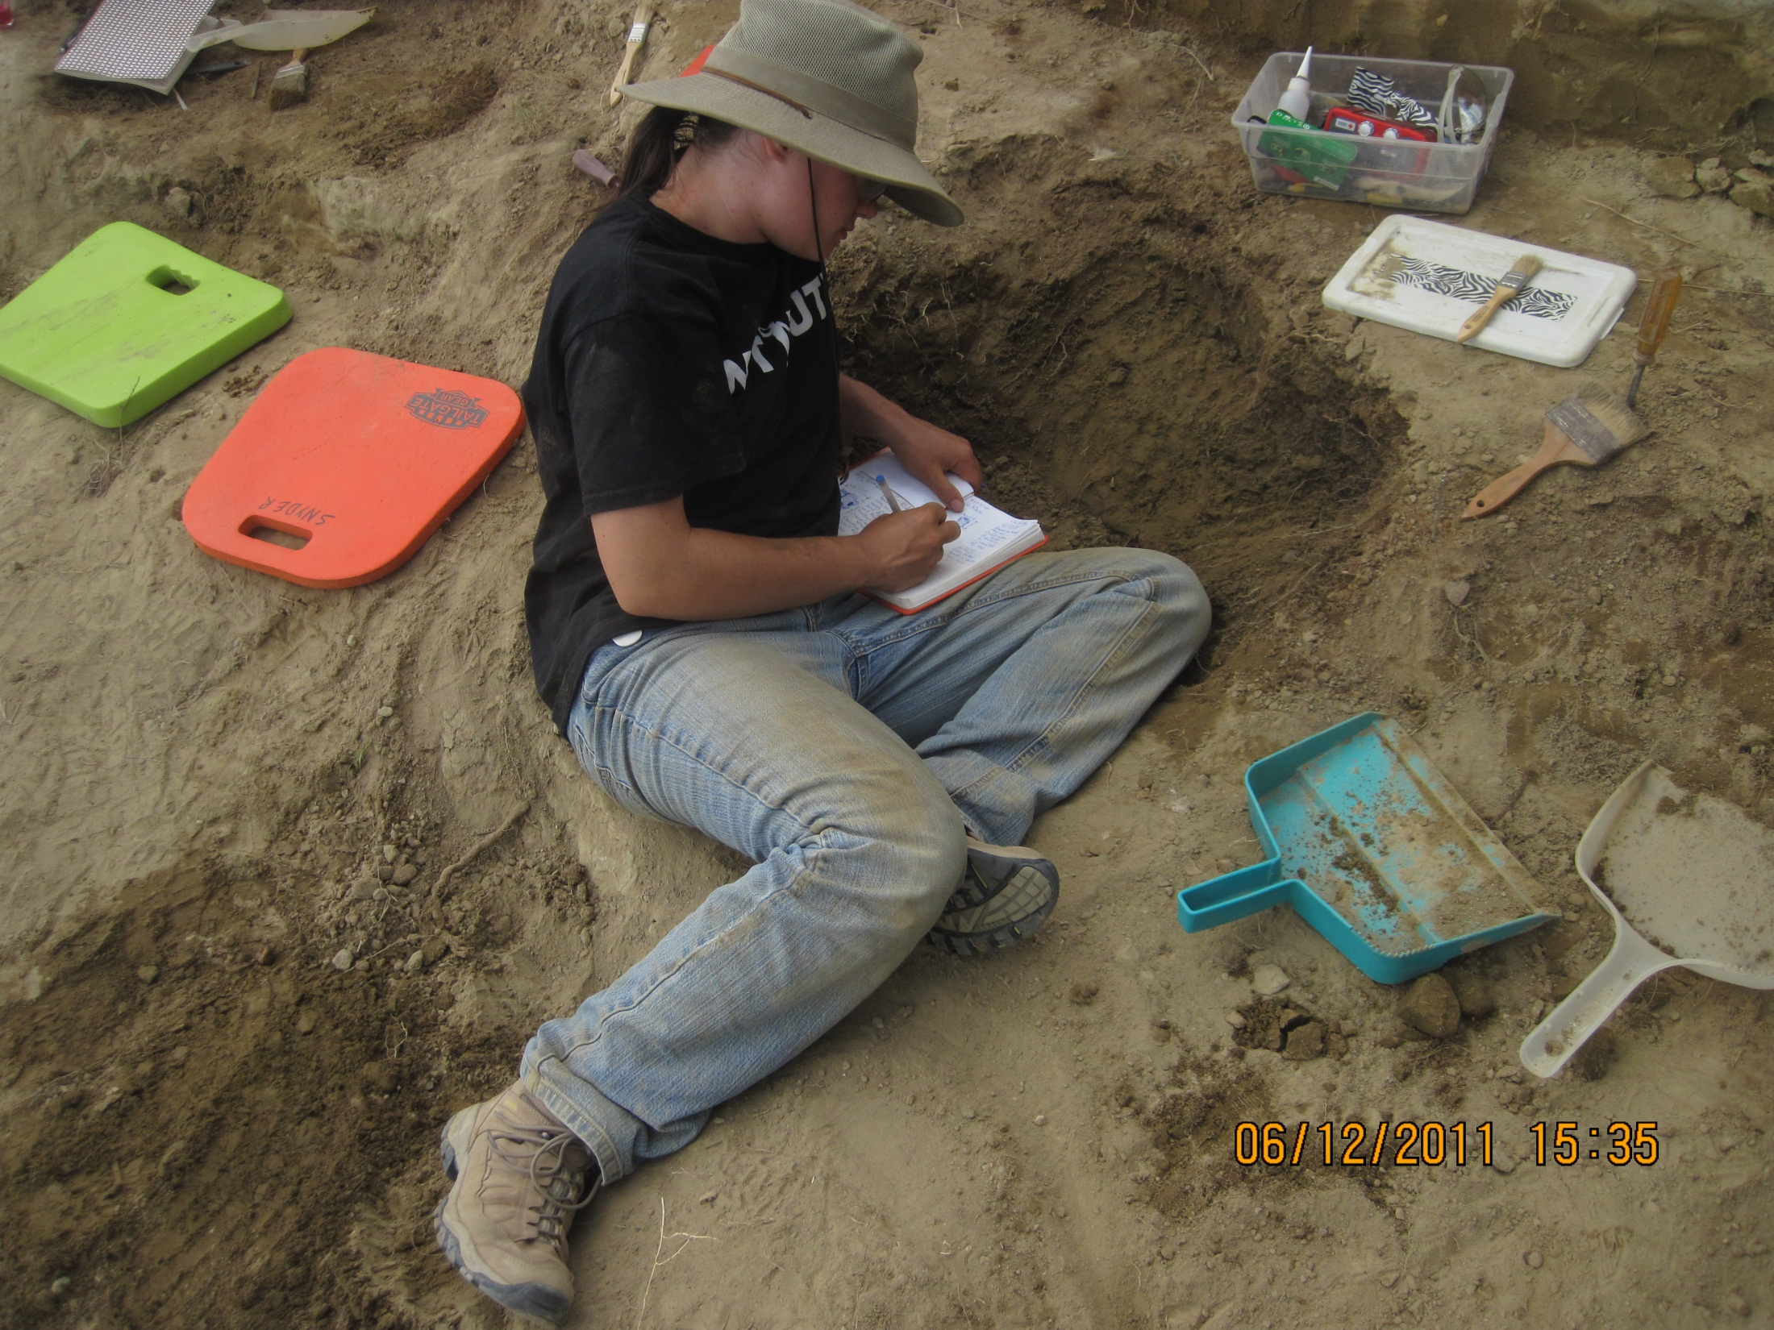
In the quarry…

Slide 38
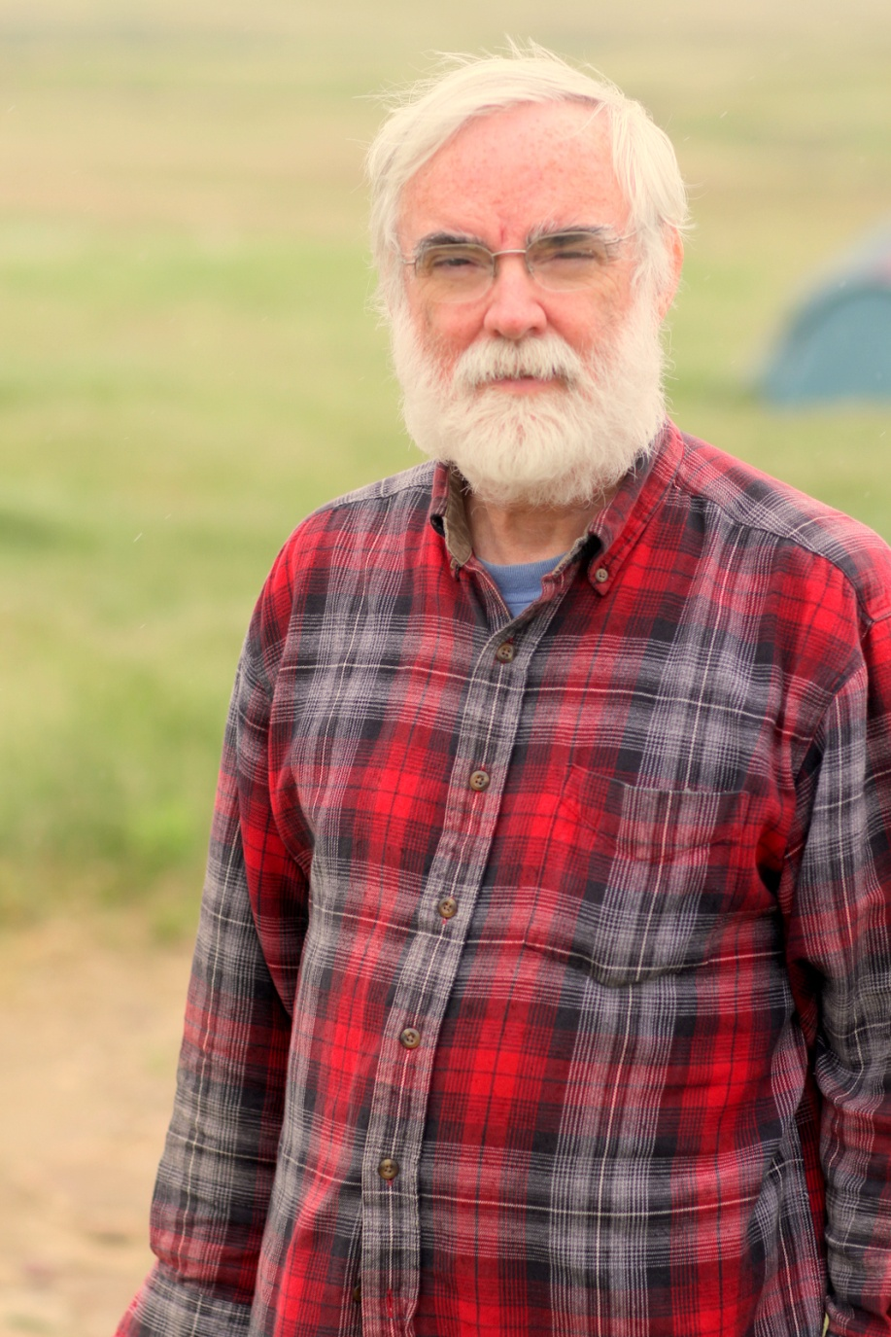
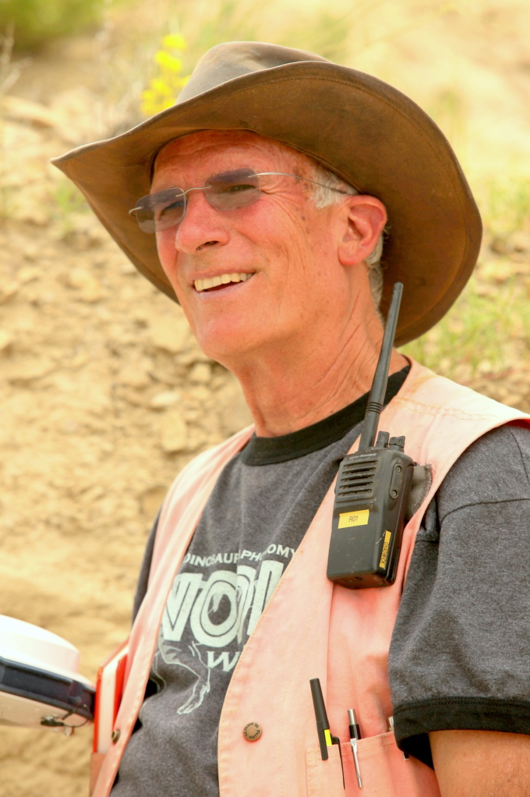
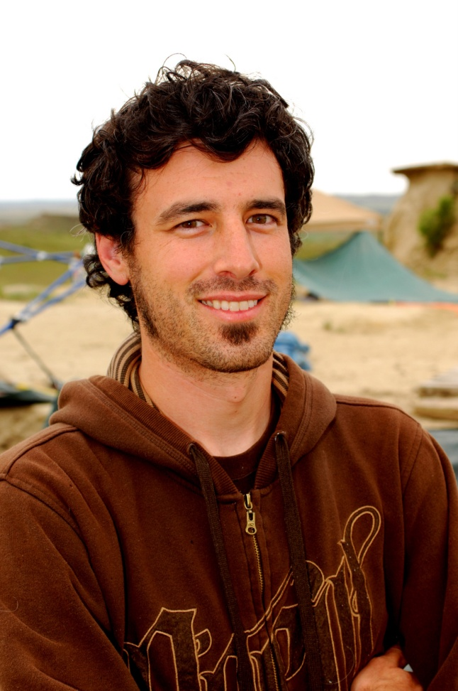
Larry Turner, Ph.D.
Geophysics
Art Chadwick, Ph.D.
Geology
Justin Woods,
Technical Director

Slide 39
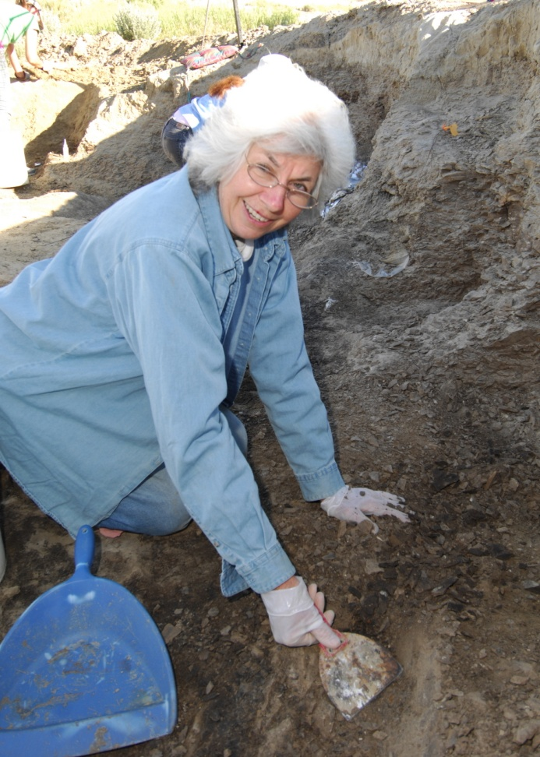
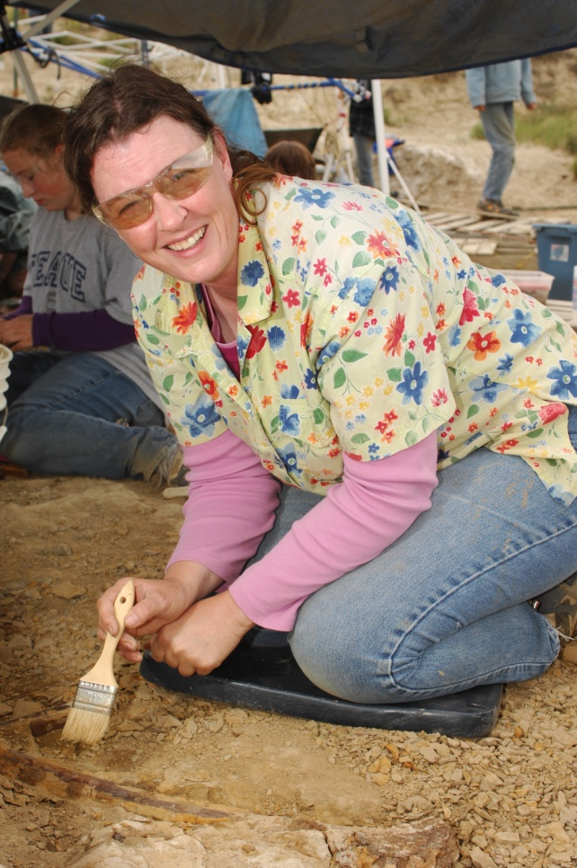
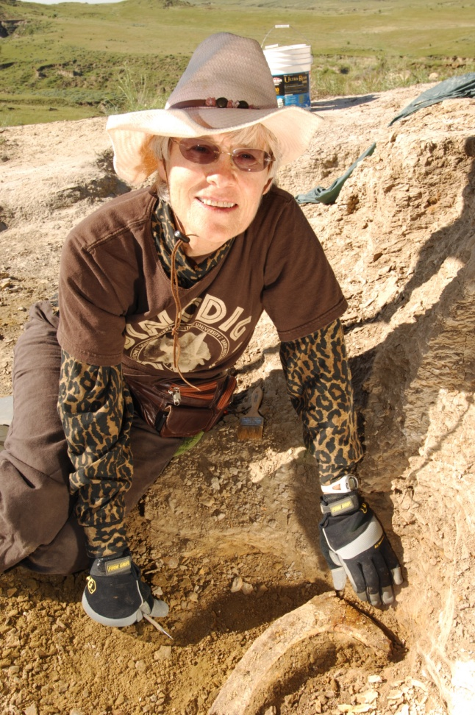
Staff
Kathleen Wilson
Quarry Leader 18 yrs
Amy Teague
Quarry Leader
12 Years
Tyke Connell
Quarry Leader
14 Yrs

Slide 40
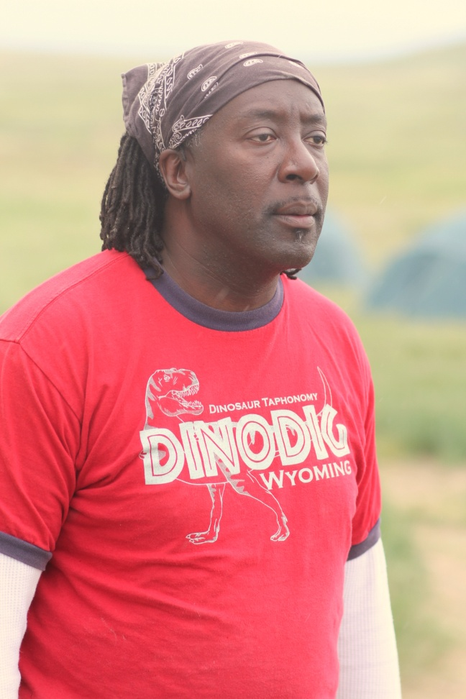
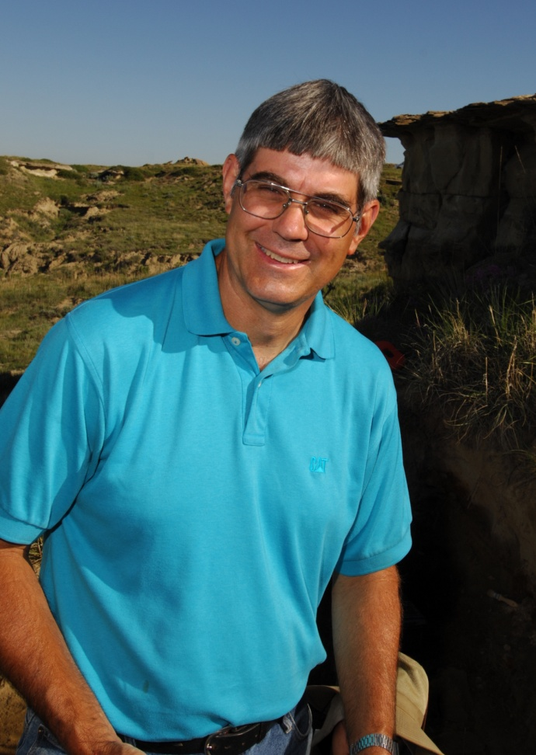
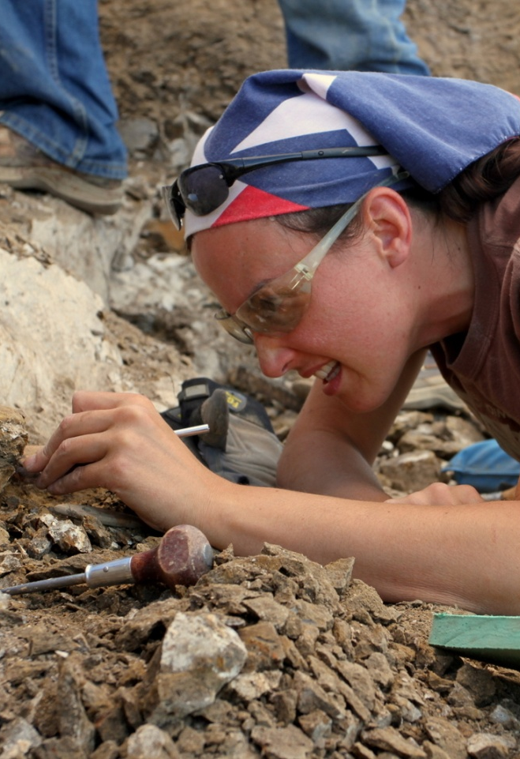
Staff
Keith Snyder,
Ph.D., Quarry Leader 9 Yrs
Stefan Gray
Quarry Leader
9 Yrs
Zury Franco, MD
Fossil Expert
9 Yrs

Slide 41
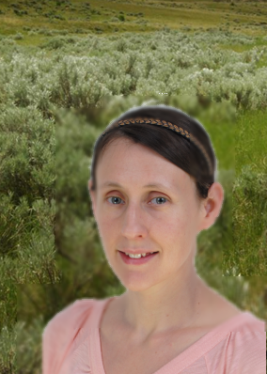
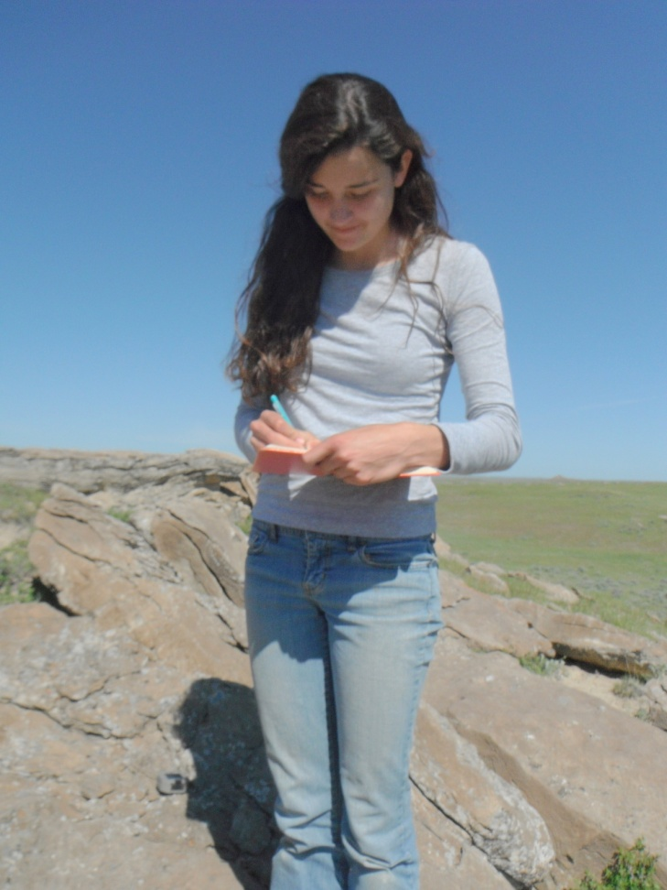
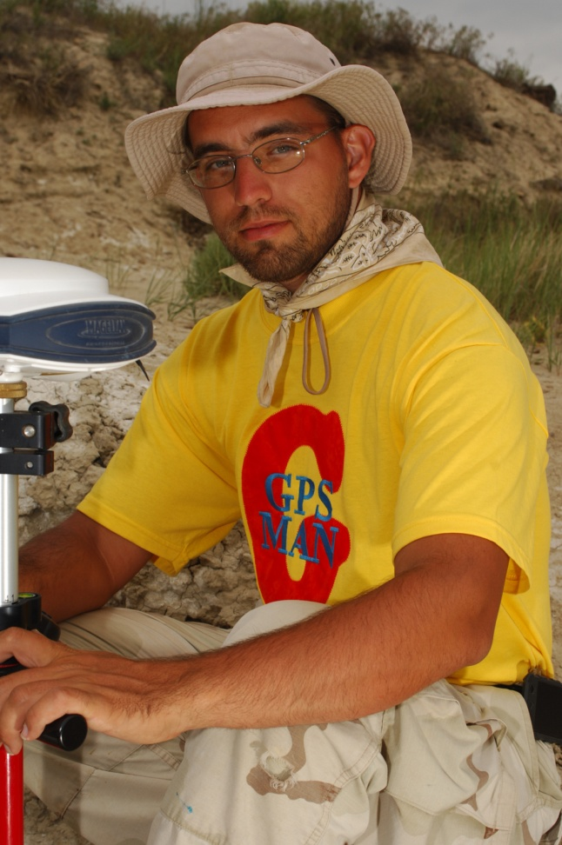
Erin Maloney, Ph.D.
Quarry Leader 9 Yrs
Rose Weeks
Sedimentology
6 Yrs
Michael Harriss Chief Technician
9 Yrs

Slide 42
Our Research
A Taphonomic Approach to understanding one of the largest dinosaur bonebeds in the world.
Taphonomy is the study of everything that happens from the time an organism dies until it is excavated.
Taphonomy includes cause of death, post-mortem history, and any changes that have occurred after burial.

Slide 43
GPS-GIS Technology
Mapping bones using high resolution GPS.
GPS data is combined with digital photos of bones in the computer.
The bones can then be seen in the computer just as they looked in the ground , but with the dirt removed.

Slide 44
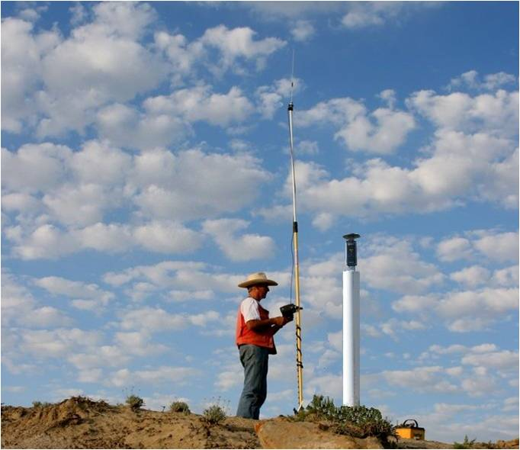
Base Station

Slide 45
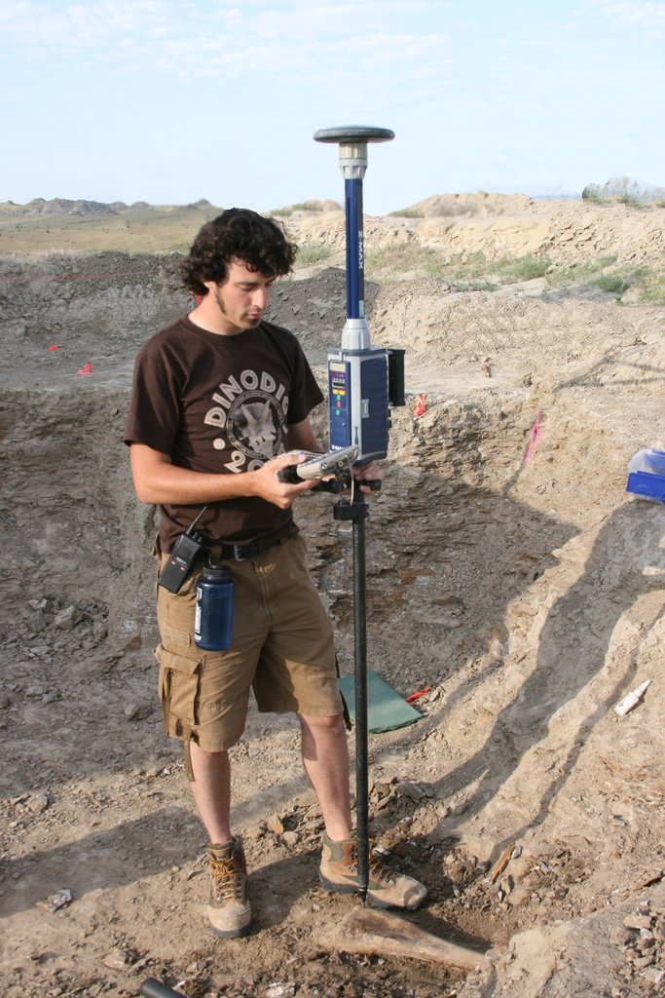
Rover

Slide 46
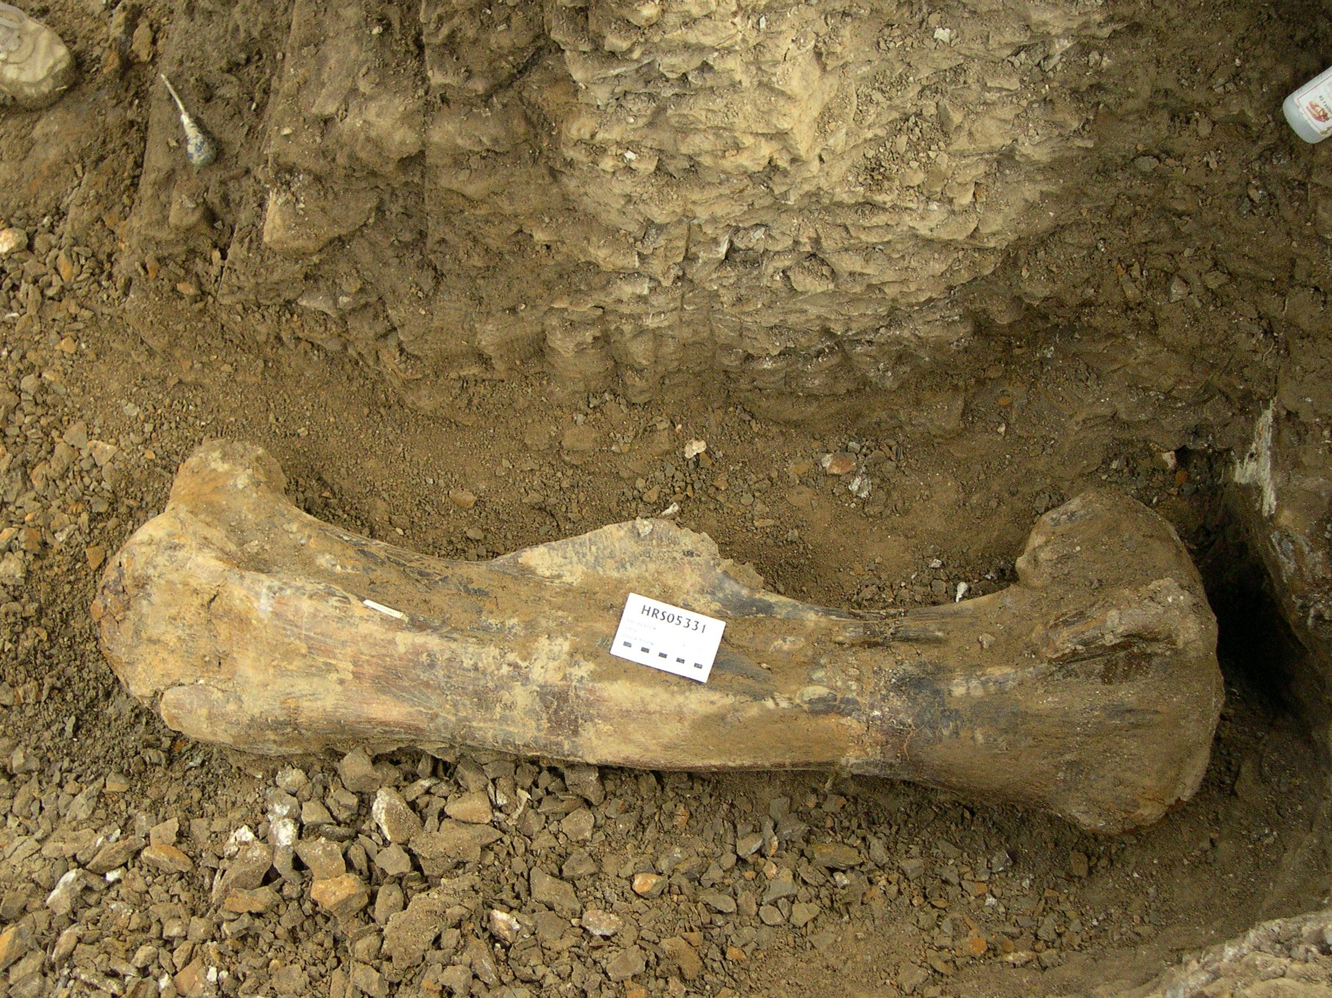
Picture

Slide 47
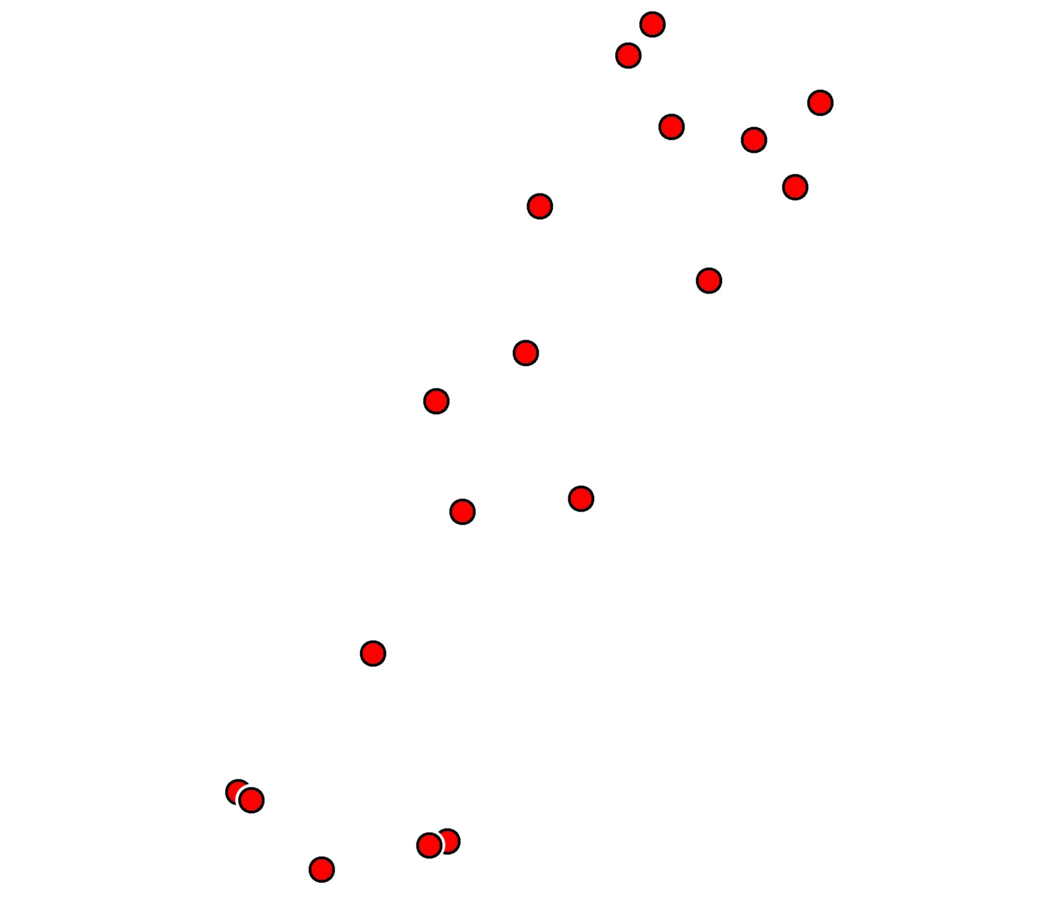
Data Points

Slide 48
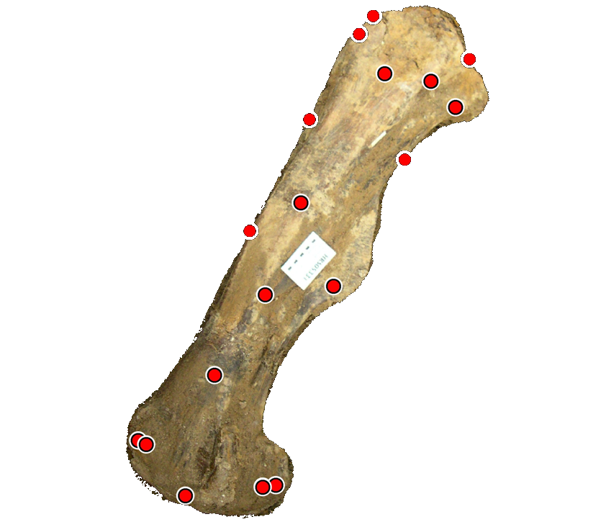
Superimpose
Picture on
Data Points

Slide 49

Final Product

Slide 50
Main Quarries
Turner (North) Quarry
An example

Slide 52




Slide 53

NORTH QUARRY 1999

Slide 54

NORTH QUARRY 2000

Slide 55

NORTH QUARRY 2001

Slide 56

NORTH QUARRY 2002

Slide 57

NORTH QUARRY 2003

Slide 58

NORTH QUARRY 2004

Slide 59

NORTH QUARRY 2005

Slide 60

NORTH QUARRY 2006

Slide 61

NORTH QUARRY 2007

Slide 62

NORTH QUARRY 2008

Slide 63
NORTH QUARRY 2009

Slide 64

NORTH QUARRY 2010

Slide 65

NORTH QUARRY 2011

Slide 66

NORTH QUARRY 2012

Slide 67

NORTH QUARRY 2013

Slide 68

NORTH QUARRY 2014

Slide 69

NORTH QUARRY 2015

Slide 70

NORTH QUARRY 2016

Slide 72

SOUTH QUARRY 2015

Slide 73


SOUTHEAST AND TEAGUE QUARRIES 2015

Slide 74

STAIR QUARRY 2011
Nanotyrannus bones

Slide 75

Nanotyrannus maxillary

Slide 76

Nanotyrannus dentary

Slide 77

OUTLYING QUARRIES – Tri. II

Slide 78


Slide 79


Slide 80


Slide 81


Slide 82


Slide 83

Thescelosaurus neglectans

Slide 85
Standard Taphonomic
Model

Slide 86
Standard Taphonomic Model for Major Dinosaur Bonebed
Dinosaurs crossing river at flood stage.
Some drowned and were swept downstream to a bend in the river where their carcasses came to rest.
Year after year this happened, resulting in accumulation of a massive bonebed.

Slide 87
Nature of the Bonebed
1. Bones lack consistent orientation
2. Most are disarticulated
3. Bones occur in normally graded bed
4. Some sorting by bone type
5. Bones are very well preserved with little evidence of weathering or abrasion.
6. Conservative estimate 5,000+ animals buried in bone bed.

Slide 88

1. Bones LACK ORIENTATION
N
Site 1
h
Site 2
Site 4

Slide 89

Long-bone Orientation – North Quarry

Slide 90

Long-bone Orientation – S.E. Quarry

Slide 91

Long-bone Orientation – South Quarry

Slide 92
2. Most are DISARTICULATED
Horizontal distribution is random

Slide 93

Site 2 example - ribs
Horizontal Distribution

Slide 94
3. Bones occur in
NORMALLY GRADED BED
Some sorting by bone type

Slide 95

0.6 - 0.8 meters
Quarry 2
Vertical Distribution

Slide 96

0.4 - 0.6 meters
Vertical Distribution

Slide 97

0.2 - 0.4 meters
Vertical Distribution

Slide 98


0.0 - 0.2 meters
Vertical Distribution

Slide 99
4. Bones are VERY WELL PRESERVED with little evidence of weathering or abrasion

Slide 100



Pristine Bones

Slide 101
5. Conservative estimate 5,000 animals buried in bone bed

Slide 102

Bones Identified

Slide 103

Yellow
overburden
Not yet excavated

Slide 104

Black is potential
Bone Bed
Not yet excavated

Slide 105

Guesstimation

Slide 106
Standard Model Explanation
If standard model is true, what observations would support it?
Bone beds with animals at various levels representing successive events.
NO; a single graded bed means a single rapid event was involved.
Carcasses in various states of disarticulation but bones of individuals generally still associated.
NO; rarely are bones still associated.

Slide 107
Standard Model Explanation – cont.
Bones should show evidence of weathering (weather checking) and surface oxidation.
NO; bones are generally pristine.
Bones should be buried in relatively coarse clastic fluvial sediments.
NO; bones are buried in very fine grained clay and mud, overlain by sandstone containing glauconite (marine).
Associated fossil flora and fauna should be consistent with fluvial accumulations.
NO; find marine elements mixed with brackish, freshwater, and terrestrial forms.

Slide 108
Alternative model
Graded bone bed in mudstone is best explained as a density current deposited rapidly in deeper water.
The widespread sharp upper contact of the bone-containing claystone with fine-grained immature sandstone is best explained by deposition in deeper water.
The presence of peloidal glauconite is generally considered an indicator of shelf deposition.
Dinoflagellates and acritarchs are more consistent with a shelf environment.

Slide 109
Alternative model – cont.
The presence of abundant teeth of what are now marine organisms are best explained in a marine setting.

Slide 110

Depositional Setting

Slide 111
Conclusions
An unusual and VERY RICH bone bed in eastern Wyoming is opening a window into the past.
It is widely acknowledged that dinosaurs and many other forms were killed by a catastrophe of global proportions.
Even early in our investigation, we find abundant evidence for catasrophic death and burial that fits within a global flood scenario.
Weighing alternative explanations is always a good thing in science.

Slide 112


Slide 113


Slide 114
Online Fossil Museum https://fossil.swau.edu
Dinosaur Research Project http://dinosaurproject.swau.edu

Slide 116
6IHPX2jOYJ

