Slide 1
Carbon-14 in Fossil Carbon,
Or,
The Missing Presentation
Paul Giem
Loma Linda University

Slide 2
The Missing Presentation
2012 meeting of the American Geophysical Union and the Asia Oceania Geosciences Society
11-15 August, Singapore
http://www.asiaoceania.org/aogs2012/mars2/timetable.asp

Slide 3
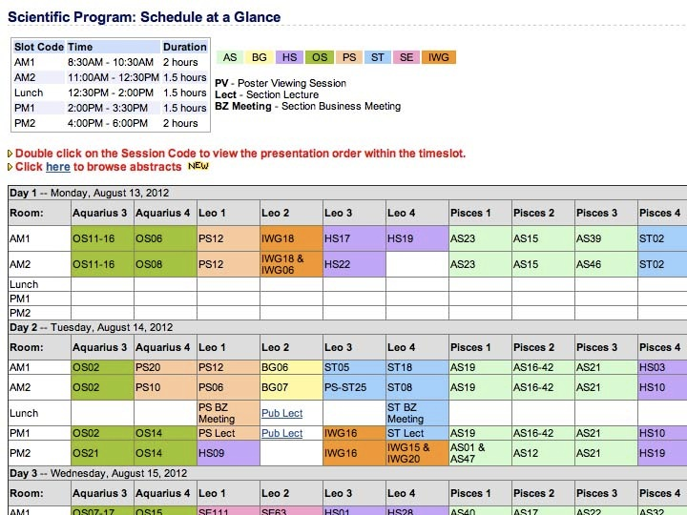

Slide 4
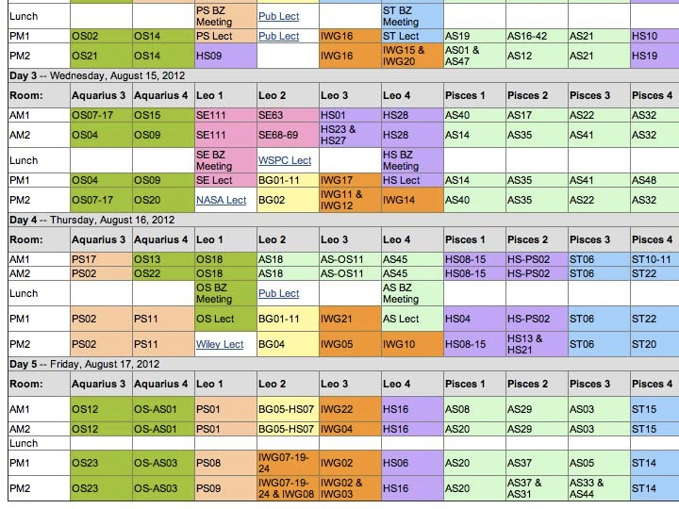

Slide 5
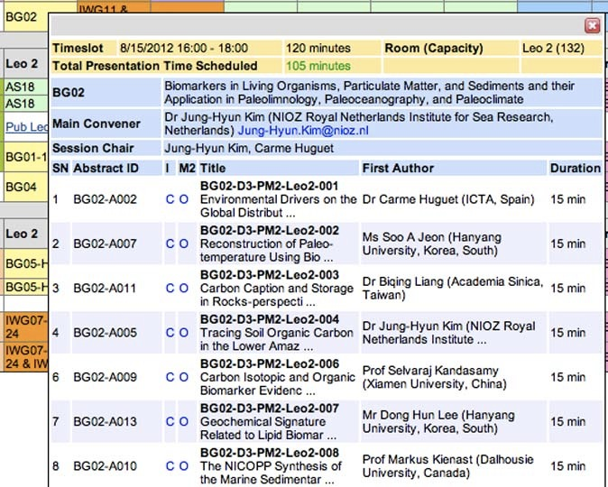

Slide 6
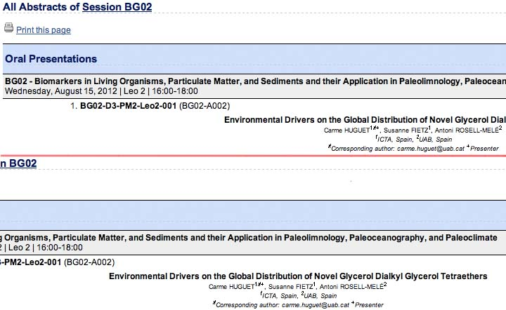
http://www.asiaoceania.org/aogs2012/mars2/pubViewAbs.asp?sMode=session&sId=2&submit=Browse+Abstracts

Slide 7
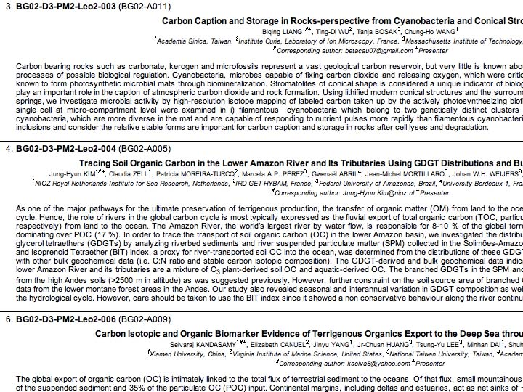

Slide 9
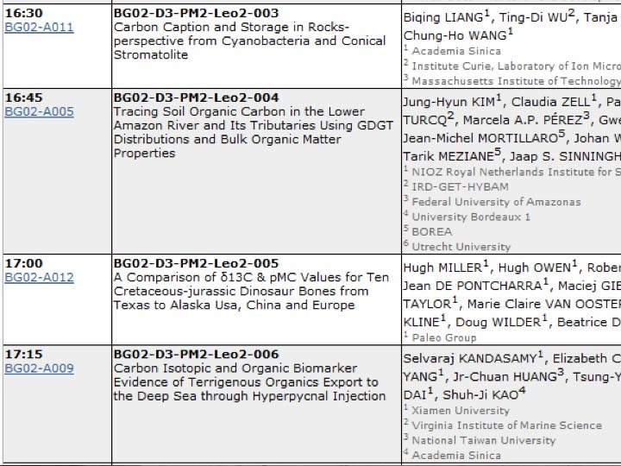

Slide 10
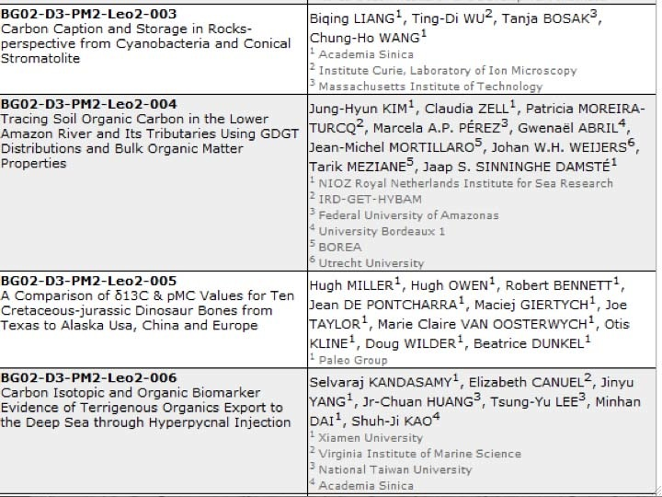

Slide 11
BG02-A012 A Comparison of δ¹³C & pMC Values for Ten Cretaceous-jurassic Dinosaur Bones from Texas to Alaska Usa, China and Europe
Hugh MILLER^{1#+}, Hugh OWEN¹, Robert BENNETT¹, Jean DE PONTCHARRA², Maciej GIERTYCH³, Joe TAYLOR¹, Marie Claire VAN OOSTERWYCH², Otis KLINE¹, Doug WILDER¹, Beatrice DUNKEL¹
¹Paleo Group, United States, ²Paleo Group, France, ³Paleo Group, Poland
#Corresponding author: hugocl4@aol.com ⁺Presenter

Slide 12
[Abstract]
Presented here are results of studies comparing δ¹³C and percent of modern ¹⁴C (pMC) for various bone fractions such as residual collagen, in-situ CaC0₃ (in bioapatite), etc. from eight dinosaurs from TX to AK and one from China. The Accelerated Mass Spectrometer (AMS) was used for 20 of 22 samples primarily at University of Georgia (USA) with Sensitivity ≥50,000 RC years. All samples were pretreated to remove contaminants. The two large samples were tested on conventional equipment as another cross check.

Slide 13
[Abstract]
The δ¹³C range was -20.1 to -23.8 for collagen and -3.1 to -9.1 for CaC0₃ with the pMC range of 6.45 to 0.76 which translates to apparent ages of 22,020±50 for CaC0₃ in a Psittacosaurus from the Gobi Desert to 39,230±140 RC years for CaCO₃ in a Triceratops from Montana. Included in this study were an Allosaurus, Acrocanthosaurus, Apatosaurus, two Triceratops and three Hadrosaurs. Documentation will include dinosaur verifications, geological formations, δ¹³C, pMC's, ¹⁴C methodologies and laboratories.

Slide 14
[Abstract]
When 2g of a Belgium Mosasaur were pretreated to remove contaminants the pMC was 4.68 or 24,600 RC years (Lindgren et al. 2011, PloS ONE, page 9). This Mosasaur age was also concordant with pMC’s for dinosaurs from TX to AK and China (no δ ¹³C).

Slide 15
[Abstract]
δ¹³C values in this study were similar to dinosaur δ¹³C values from the Judith River formation in Alberta, Canada that also reported δ¹⁵N but not pMC’s (Ostrom et al. 1993, Geology, v. 21). Radiocarbon methods are valuable in geochronology (accuracy to ≥40,000 RC years in varved Lake Suigetsu, Japan). Sediments deposit as function of particle size and density, not time in moving waters so this helps explain pMC’s in dinosaur bones (Berthault 2002, Geodesy and Geodynamics 22, China). Primary areas for further fossil studies would be Alberta, Canada, Gobi Desert and Zhucheng, China.

Slide 16
The Missing Presentation
The presentation is on YouTube
https://www.youtube.com/watch?v=QbdH3l1UjPQ

Slide 21
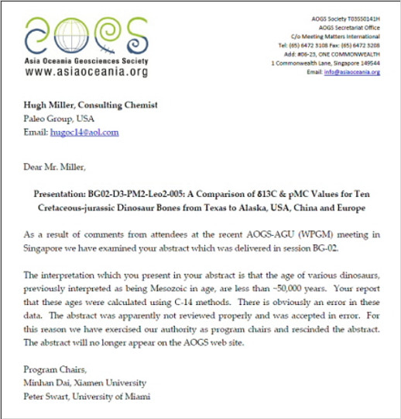

Slide 22
The Missing Presentation
As a result of comments from attendees at the recent AOGS-AGU (WPGM) meeting in Singapore we have examined your abstract which was delivered in session BG-02.

Slide 23
The Missing Presentation
The interpretation which you present in your abstract is that the age of various dinosaurs, previously interpreted as being Mesozoic in age, are less than ~50,000 years. Your report that these ages were calculated using C-14 methods. There is obviously an error in these data. The abstract was apparently not reviewed properly and was accepted in error. For this reason we have exercised our authority as program chairs and rescinded the abstract. The abstract will no longer appear on the AOGS web site.

Slide 24
The Missing Presentation
“After the AOGS-AGU conference in Singapore, the abstract was removed from the conference website by two chairmen because they could not accept the findings. Unwilling to challenge the data openly, they erased the report from public view without a word to the authors or even to the AOGS officers, until after an investigation. It won't be restored.”

Slide 25
Outline of Talk
Introduction
A brief explanation of how carbon-14 dating works.
An explanation of why the Paleo Group’s dinosaur data had to be suppressed
Other data that support their findings
Summary and conclusions.

Slide 26
How Does Carbon-14 Dating Work?
Carbon-14 is made in the atmosphere by cosmic rays
Atoms are shattered, producing neutrons
Neutrons hit Nitrogen-14 and produce Carbon-14
This production is relatively constant at present

Slide 27
How Does Carbon-14 Dating Work?
Carbon-14 mixes in with ordinary carbon, first in the atmosphere, then in the biosphere*
Carbon-14 is found throughout the biosphere
The concentration of carbon-14 in today’s biosphere is approximately 1 part in a trillion (10⁻¹²) of ordinary carbon
Carbon-14 gradually decays back to N-14

Slide 28
The uniformitarian model
The ratio of carbon-14 to ordinary carbon (¹⁴C/C ratio) in the atmosphere has always been constant
Plants get carbon from the atmosphere with this ¹⁴C/C ratio
Animals eat plants with this ¹⁴C/C ratio
When plants and animals die, or plants lay down wood, the carbon-14 starts to decay
Carbon-14 decays at an exponential rate
If you measure the ¹⁴C/C ratio of a dead plant or animal, you can predict when it lived

Slide 29
Formulas for finding age by the uniformitarian model
¹⁴C/C = (¹⁴C/C)₀ e ^{-kt}
t = ln ((¹⁴C/C)₀ / ¹⁴C/C) / k
(where k = ln (2) / t_{1/2})
t_{1/2} = 5,568 years

Slide 30
Why Did the Paleo Group’s Data Have to Be Suppressed?
Residual carbon-14 is incompatible with millions of years
In 1 million years, the entire earth’s weight in carbon-14 would be gone
5.972 ⋅ 10²⁷ g * 6.02 ⋅ 10²³ atoms/mole / 14 g/mole
2.568 ⋅ 10⁵⁰ atoms→ 167.5 half lives
1,000,000 years / 5730 years/half life =174.5 half lives
167.5 – 174.5 = –7
At 250,000 years less than an atom per gram C is left

Slide 31
Why Did the Paleo Group’s Data Have to Be Suppressed?
Residual carbon-14 is compatible with short age
What is measured is the ¹⁴C/C ratio
Less carbon-14 in the past
Much more ordinary carbon in the past
4,300 years not unreasonable
Residual carbon-14 is incompatible with long ages

Slide 32
A Brief History
Residual carbon-14 has been predicted by creationists since at least 1970.
Apparent residual carbon-14 has been noted by creationists since at least 1988
I noted published data suggesting residual carbon-14, and called for experiments, in 1997
Andrew Snelling did several dates on his own starting in 1997
I called for testing creationist models in 2000*, and reviewed the literature in 2001

Slide 33
A Brief History
The RATE group dated coal samples, and diamonds
Baumgardner J, 2005. Carbon-14 Evidence for a Recent Global Flood and a Young Earth. In Radioisotopes and the Age of The Earth: Results of a Young-Earth Creationist Research Initiative, (Volume II), L. Vardiman et al., eds.
http://www.icr.org/i/pdf/technical/Carbon-14-Evidence-for-a-Recent-Global-Flood-and-a-Young-Earth.pdf

Slide 34
The RATE Group
TX
ND
MT
UT
UT
AZ
KY
PA
PA
IL
Eocene
(40 Ma)
Cretaceous
(100 Ma)
Pennsylvanian
(300 Ma)

Slide 35
The RATE Group
Dated diamond (Precambrian)
Appears to be above background (± 2 SD)

Slide 36
A Brief History
Taylor RE, Southon J, 2007. Use of natural diamonds to monitor ¹⁴C AMS instrument backgrounds. Nucl. Instr. and Meth. in Phys. Res. B 259:282–287
Available at http://www.scribd.com/doc/182086583/Taylor-Southon-NI-M-B-2007-pdf

Slide 37
The UCI Diamond Data in Chronological Order

Slide 38
A Brief History
Rotta published an article on carbon-14 from radium
Carbon-14 was measured in natural gas wells
The mosasaur data were published
The Paleo Group presented its data

Slide 39
Where Are We Now?
Carbon-14 is consistently measured in fossil carbon
Machine error can be eliminated
Nuclear synthesis underground is orders of magnitude too small to account for the data
Underground contamination is unrealistic
Laboratory contamination is increasingly unrealistic

Slide 40
Where Are We Now?
Kirk Bertsche
http://www.talkorigins.org/faqs/rate-critique.html
“While this conclusion explains the higher values for the biological samples in general, it does not account for all the details. Some biological samples do have radiocarbon levels not explainable by sample chemistry. These samples are mostly coals and biological carbonates, both of which are prone to in situ contamination.”
“Unlike the literature values, Baumgardner’s coal samples do show significant radiocarbon above background, inviting explanation.”

Slide 41
Where Are We Now?
Harry Gove, as summarized by Kathleen Hunt ( http://www.talkorigins.org/faqs/c14.html ), states:
“The short version: the ¹⁴C in coal is probably produced de novo by radioactive decay of the uranium-thorium isotope series that is naturally found in rocks (and which is found in varying concentrations in different rocks, hence the variation in ¹⁴C content in different coals). Research is ongoing at this very moment.”

Slide 42
Where Are We Now?
Carbon-14 is consistently measured in fossil carbon
Machine error can be eliminated
Nuclear synthesis underground is orders of magnitude too small to account for the data
Underground contamination is unrealistic
Laboratory contamination is increasingly unrealistic
Comparison of fossil carbon and some other standard should be attempted
The most reasonable hypothesis is that there is residual carbon-14 in fossil carbon

Slide 43
Outline of Talk
Introduction
A brief explanation of how carbon-14 dating works.
An explanation of why the Paleo Group’s dinosaur data had to be suppressed
Other data that support their findings
Summary and conclusions.

Slide 44
What to Expect
Don’t expect this to get into the “peer-reviewed literature”
Four classes of creationist research
Those that make creationism harder to maintain
Those that are neutral
Those that solve problems for creationism
Those that strike at the heart of atheism
Those that show the need for an intelligent designer
Those that present a strong argument for short age
The latter will only get published if someone does not realize the stakes involved

Slide 45
What to Expect
One does not have to be venal and cynical to oppose such research being published
One only has to “know” that the opposition can’t possibly be right, so there must be some flaw in the research, and that this research will be “unfairly” damaging if published (and besides, one’s opposition resists the truth and is dishonest)
Some on the creationist side do this also, so we need to temper our criticism of evolutionists who do it

Slide 46
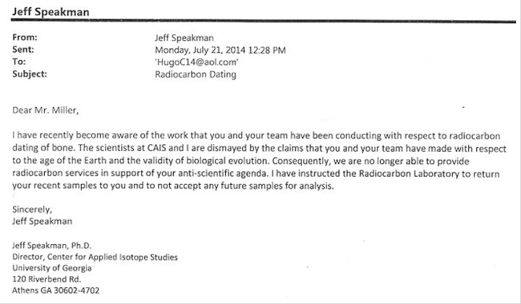
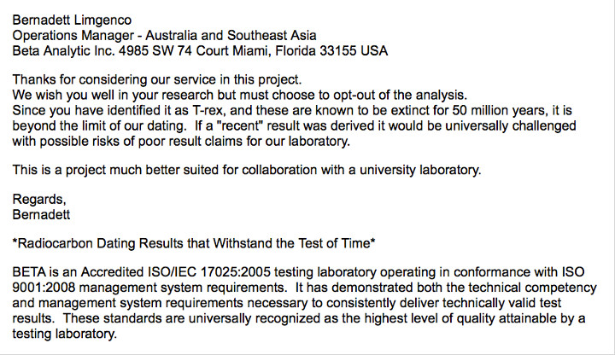
Where Do We Go from Here?
The Paleo Group has been told that they cannot get any more of their samples dated
By the University of Georgia lab
By a commercial lab
I have found the same problem
The lab that cooperated with the RATE group, in spite of never being explicitly identified, saw their funding draw up
We may have to have our own lab

Slide 47
Questions and Comments

