Slide 1
You are free to use this presentation for your own personal study, or for lectures in a classroom setting. Feel free to modify and improve it for classroom use in any way that you see fit. I ask that it not be redistributed in whole or in part for any purpose without my written permission. If you would like to use it for some other purpose, or wish to share it using any media please contact me at:
tstandish@llu.edu
Thank you for respecting my wishes with this.

Slide 2
grisda.org

Slide 3
Evolution & Society
Timothy G. Standish, PhD

Slide 4
For you created my inmost being; you knit me together in my mother’s womb.
I praise you because I am fearfully and wonderfully made; your works are wonderful, I know that full well.
Psalm 139:13,14 NIV

Slide 5
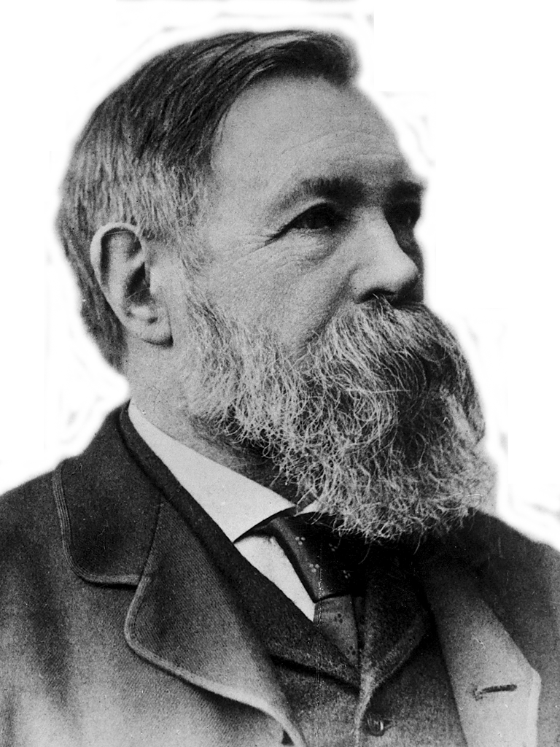
Just as Darwin discovered the law of evolution in
organic nature, so
Marx discovered the
law of evolution in
human history.
Friedrich Engels 1883
Notes:
This was Frederick Engels’ Speech at the Grave of Karl Marx Highgate Cemetery, London. March 17, 1883.
http://www.marxists.org/archive/marx/works/1883/death/burial.htm

Slide 6
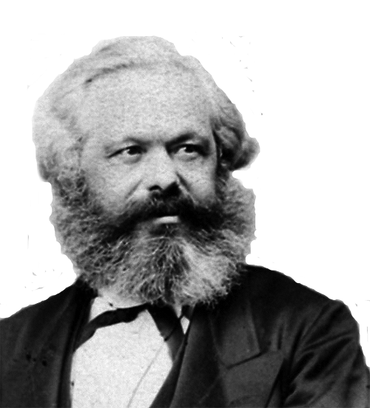
Although it is developed in
the crude English style,
this is a book [Origin
of Species] which
contains the basis
of natural history
for our views.
Karl Marx
Notes:
1860

Slide 7
The history of all hitherto existing
society is the history of class struggles.
Die Geschichte aller
bisherigen Gesellschaft
ist die Geschichte von Klassenkämpfen.
Karl Marx and
Friedrich Engels
Notes:
Communist Manifesto Chapter I. Bourgeois and Proletarians

Slide 8
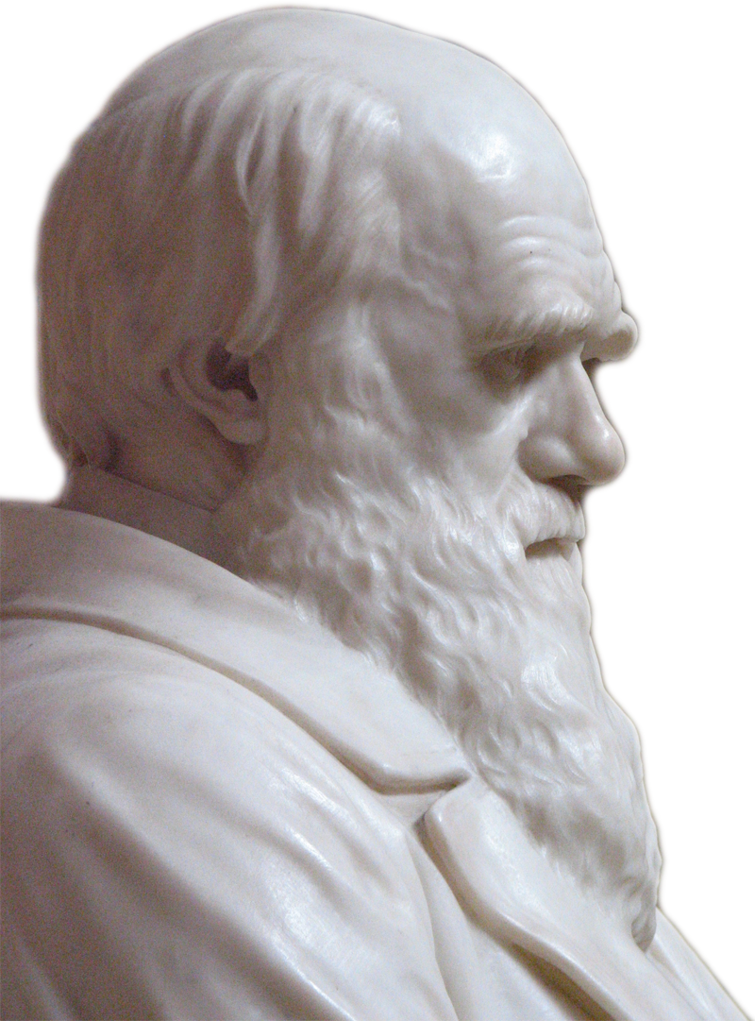
And we have seen in the chapter on the Struggle for Existence that it is the most closely-allied forms,--varieties of the same species,
and species of the same genus or
related genera… Generally
come into the severest
competition with each other.
Consequently, each new
variety or species, during the
progress of its formation, will
generally press hardest on its
nearest kindred, and tend to
exterminate them.
Charles Darwin, 1859
Notes:
Darwin, C. R. 1859. On the Origin of Species by Means of Natural Selection, or the Preservation of Favoured Races in the Struggle for Life. First edition. John Murray, London. Pg. 110.

Slide 9
Had he [man] not been subjected during primeval times
to natural selection,
assuredly he would
never have attained
to his present rank.
Charles Darwin, 1888
Notes:
Darwin, CR. 1888. The Descent of Man, and Selection in Relation to Sex. 2nd Edition Vol. 1, John Murray, London. pg 119.

Slide 10
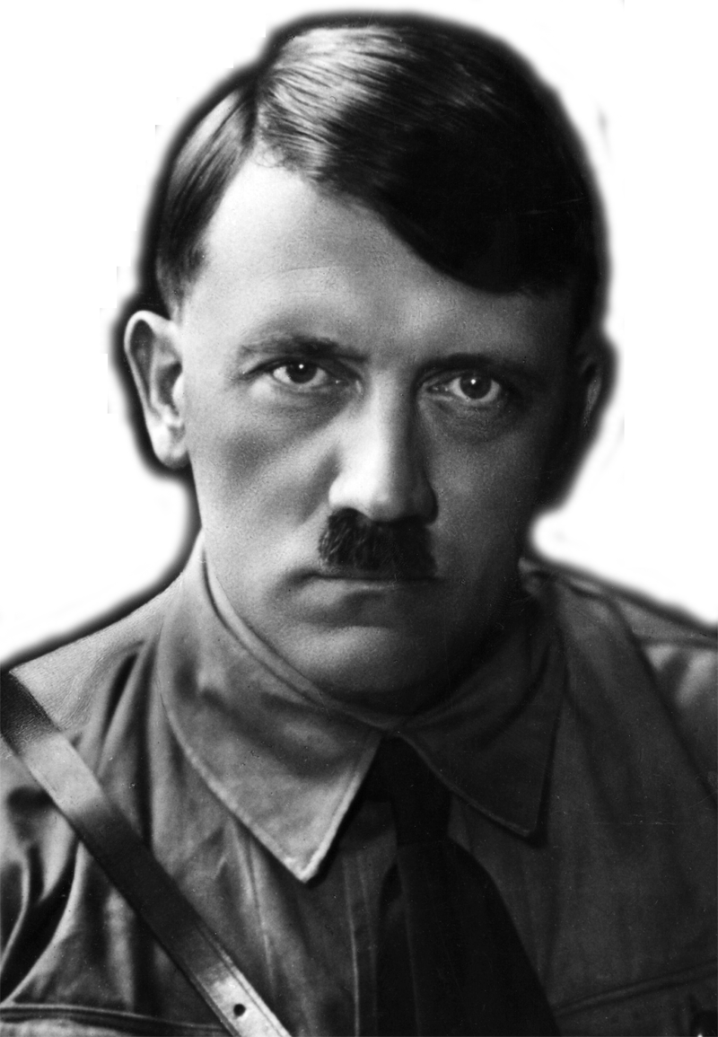
By means of the struggle, the
élites are continually renewed.
The law of selection justifies
this incessant struggle, by
allowing the survival of the
fittest. Christianity is a
rebellion against natural law, a a protest against nature. Taken to to its logical extreme,
Christianity would mean
the systematic cultivation
of the human failure.
Adolf Hitler, 1941-1944
Notes:
Adolf Hitler, Hitler's Table Talk, 1941-1944: His Private Conversations (trans. Norman Cameron and R.H. Stevens Introduced and with a new Preface by H.R. Trevor-Roper; New York: Enigma Books, 2000), 51.
Hitler wrote at least one other book, commonly called Hitler’s Zweites Buch, that was only published after his death: Adolf Hitler, Hitler's Second Book: The Unpublished Sequel to Mein Kampf. (ed. Gerhard L. Weinberg; trans. Krista Smith; New York: Enigma Books, 2003).

Slide 11
Defend the weak and the fatherless; uphold the cause of the poor and the oppressed. Rescue the weak and the needy; deliver them from the hand of the wicked.
Psalm 82:3,4

Slide 12
Imago Dei
The Biblical view is that humans were created by the Creator God and He cares about all humans, not just the smart, powerful and healthy, but also “the least of these brothers and sisters of mine” (Matthew 25:40 NIV, Psalm 82:3,4)
It is an expression of God’s grace that he still loves humans, despite the fact that we all exhibit the repulsive effects of sin
“But God demonstrates his own love for us in this: While we were still sinners, Christ died for us.” (Romans 5:8 NIV)

Slide 13
Man in his arrogance thinks
himself a great work
worthy the
interposition of a
deity (sic), more
humble & I believe
truer to consider him
created from animals.
Charles Darwin, 1838
Notes:
12:05
Note that Darwin’s theory of evolution was not published until 1859 in the Origin of Species. This quote is from page 196-197 in Darwin’s Notebook C on transmutation as transcribed and printed in: Charles R. Darwin, “Darwin's Notebooks on Transmutation of Species Part II,” Second Notebook (February To July 1838) (ed. Gavin de Beer; London: Bulletin of the British Museum (Natural History) Historical Series 2[3], 1960), 106.

Slide 14
At some future period, not very distant as measured by centuries, the civilised races of man will almost certainly exterminate, and replace, the savage races throughout
the world. At the same time the
anthropomorphous apes, as Professor
Schaaffhausen has remarked, will no
doubt be exterminated. The break
between man and his nearest allies
will then be wider, for it will
intervene between man in a more
civilised state, as we may hope, even
than the Caucasian, and some ape as
low as a baboon, instead of as now
between the negro or Australian
and the gorilla.
Charles Darwin, 1882
Notes:
11:50
Charles R. Darwin, The Descent of Man, and Selection in Relation to Sex 2d edition. (London: John Murray, 1882), 156.

Slide 15
From one man he made all the nations, that they should inhabit the whole earth; and he marked out their appointed times in history and the boundaries of their lands.
Acts 17:26 NIV

Slide 16
Man is the result of a purposeless and natural process that did not have him in mind.
George Gaylord Simpson
Notes:
George Gaylord Simpson (1967) The Meaning of Evolution, revised edition. New Haven: Yale University Press. p. 345.

Slide 17
[A]n evolutionary perspective denies that humans are different in kind from other animals; and one cannot reasonably make distinctions in morals where none exist in fact.
James Rachels, 1990
Notes:
James Rachels, Created From Animals: The Moral Implications of Darwinism (Oxford: Oxford University Press,1990), 174.

Slide 18
If we compare a severely defective human infant with a nonhuman animal, a dog or a pig, for example, we will often find the nonhuman to have superior capacities, both actual and potential, for rationality, self consciousness, communication, and anything else that can plausibly be considered morally significant.
Peter Singer, 1983
Notes:
Peter Singer, “Sanctity of Life or Quality of Life,” Pediatrics (1983) 72[1]:128-129.

Slide 19
Singer’s Logic
Darwinism: humans are animals with no special status in the creation
The basis for human value and dignity is not rooted in their nature
Human rights are rooted in a variable quality called “personhood” related to their awareness or consciousness
Being human is not enough to ethically claim human rights such as the right to life
Notes:
11:55
Those who fall below some arbitrary level of consciousness do not qualify as persons and ethically only persons, not humans, have rights. Where exactly the threshold of consciousness is for becoming a person with the right to life is not clear.

Slide 20
[T]he more a fetus or newborn approximates - or is proximate to - personhood, the greater his or her claim to life. Likewise the further beyond the threshold of incontestably personal life an adult individual is (for example, a patient with severely advanced Alzheimer's disease is beyond that threshold), the less clear is that individual's claim to protectable life.
Walters, 1997
Notes:
James W. Walters, What is a person?: An ethical exploration (Urbana: University of Illinois Press, 1997) quoted page X in the Forward by Lawrence J. Schneiderman, the actual quote is on page 63.

Slide 21
In spite of the oxymoron in the expression, we propose to call this practice ‘after-birth abortion’, rather than ‘infanticide’, to emphasise that the moral status of the individual killed is comparable with that of a fetus (on which ‘abortions’ in the traditional sense are performed) rather than to that of a child. Therefore, we claim that killing a newborn could be ethically permissible in all the circumstances where abortion would be. Such circumstances include cases where the newborn has the potential to have an (at least) acceptable life, but the well-being of the family is at risk.
Alberto Giubilini & Francesca Minerva, 2012
Notes:
12:00
Alberto Giubilini Francesca Minerva, “After-birth abortion: why should the baby live?” Journal of Medical Ethics (2012) doi:10.1136/medethics-2011-100411
For more examples see many publications of Singer’s collaborator Helga Kuhse including, Helga Huhse, “Death by non-feeding: Not in the baby's best interests,” Journal Of Medical Humanities 7(2):79-90. Michael Tooley has also advocated similar position: Michael Tooley, “Abortion and Infanticide,” Philosophy & Public Affairs (Autumn, 1972) 2[1]:37-65.

Slide 22
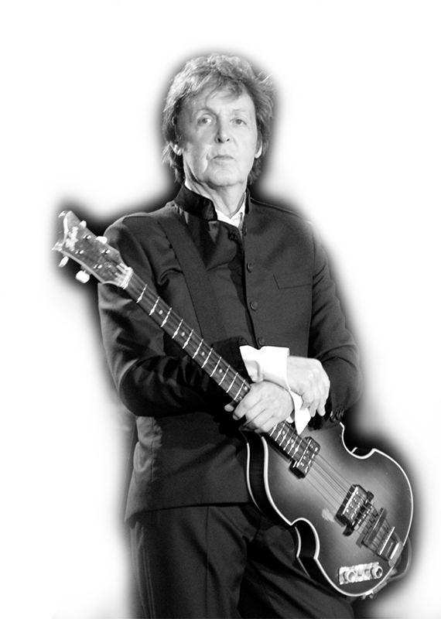
The rain comes falling from the sky,
To fill the stream that fills the sea
And that's where life began for you and me
Paul McCartney, Mamunia, 1973
Oli Gill
Notes:
Attribution: Oli Gill
Image from: http://en.wikipedia.org/wiki/Paul_McCartney#mediaviewer/File:Paul_McCartney_black_and_white_2010.jpg
The song Mamunia appears on Paul McCartney and Wings’ album Band on the Run released in 1973.
Mamunia comes from the Arabic Mamounia meaning “safe haven,” the name of a house McCartney saw in Merekesh when there. Ref: Vincent Perez Benitez. 2010. The Words and Music of Paul McCartney: The Solo Years. ABC-CLIO: Santa Barbara. P 56.

Slide 23
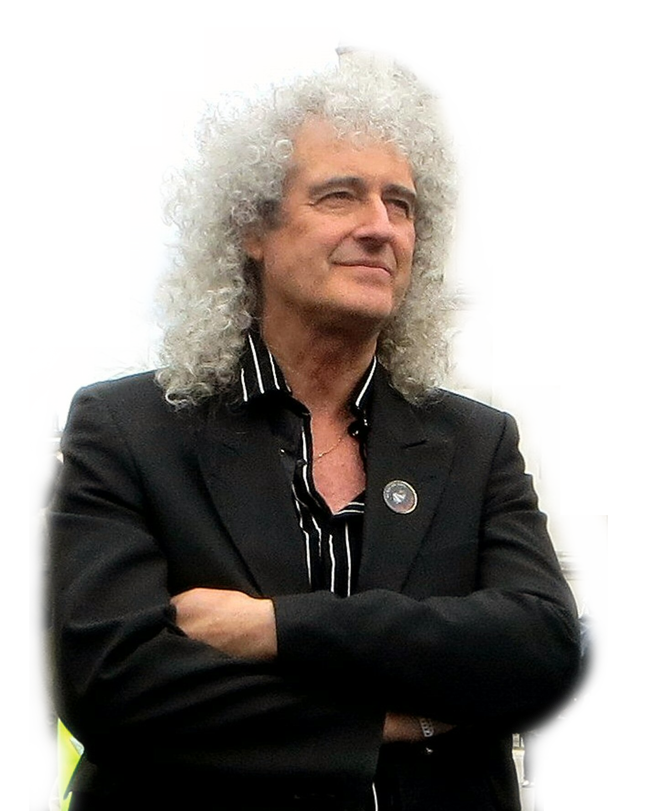
The universe: “a vast
agglomeration of
matter and energy
churning around in a
variety of ways,
evolving, never still,
never stable, and in
fact always
running down.”
Brian May
Brian Minkoff-London Pixels
Notes:
May – an astronomy PhD dropout – played lead guitar in the rock group Queen. May has now completed his PhD I think
http://www.brianmay.com/brian/brianssb/brianssboct06.html [emphasis in original].
Image modified from: http://upload.wikimedia.org/wikipedia/commons/0/0b/Brianmaywestminster.jpg
Picture credit: Brian Minkoff-London Pixels

Slide 24
He who was seated on the throne said, “I am making everything new!” Then he said, “Write this down, for these words are trustworthy and true.”
Revelation 21:5 NIV

Slide 25
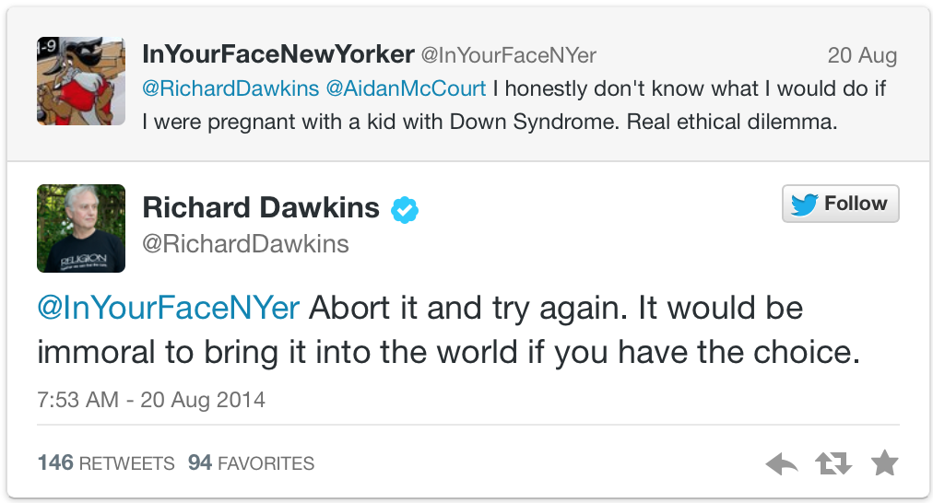
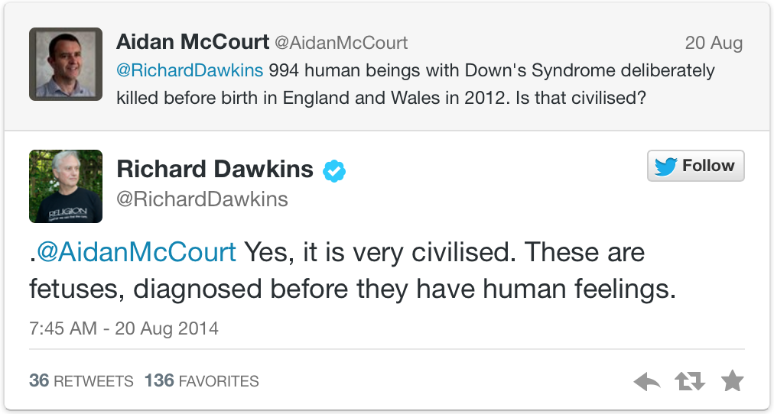
Notes:
Reference: http://www.bbc.com/news/blogs-ouch-28879659
Images are at the the same source, but these were screen shots from: http://www.theblaze.com/stories/2014/08/21/abort-it-and-try-again-atheist-richard-dawkins-ignites-firestorm-with-claim-that-its-immoral-to-knowingly-bring-a-baby-with-down-syndrome-into-the-world/#

Slide 26
Responsibility
Darwinism ultimately liberates individuals from responsibility for their actions
Free will is probably an illusion
No one can control their nature or the nurture they have experienced
Thus a person is no more responsible for their behavior than is a dog, mouse, tiger or bacterium

Slide 27
Responsibility
It is unreasonable to expect people not to act on their urges, as they are not responsible for them
Thus prohibitions against acting on sexual urges, such as sex outside marriage or homosexual behavior, are unreasonable
Taken to its logical conclusion, prohibition of and the concept of punishment for bad behavior is unreasonable as individuals can’t control their nature

Slide 28
Summary
Darwinism provides a consistent foundation for ethics
Because the Darwinist worldview is profoundly different from the Biblical worldview, ethics within the Darwinian framework are profoundly different
Central to the difference is a fundamentally different view of what human beings are
The Darwinist worldview, as it becomes integral to a society, will be reflected and perpetuated by the media produced by the society
Media amplifies the impact of Darwinism, resulting in a progressive loss of value for human life

Slide 29
For I am not ashamed of the gospel of Christ, for it is the power of God to salvation for everyone who believes, for the Jew first and also for the Greek. For in it the righteousness of God is revealed from faith to faith; as it is written, “The just shall live by faith.”
Romans 1:16,17 NKJV

Slide 30
The End
Notes:
Gilbert Meilander

Slide 31
grisda.org

Slide 32
You are free to use this presentation for your own personal study, or for lectures in a classroom setting. Feel free to modify and improve it for classroom use in any way that you see fit. I ask that it not be redistributed in whole or in part for any purpose without my written permission. If you would like to use it for some other purpose, or wish to share it using any media please contact me at:
tstandish@llu.edu
Thank you for respecting my wishes with this.

Slide 33
Let love be without hypocrisy. Abhor what is evil. Cling to what is good. Be kindly affectionate to one another with brotherly love, in honor giving preference to one another; not lagging in diligence, fervent in spirit, serving the Lord; rejoicing in hope, patient in tribulation, continuing steadfastly in prayer;
Romans 12:9-12 NKJV

Slide 34
There is neither Jew nor Gentile, neither slave nor free, nor is there male and female, for you are all one in Christ Jesus.
Galatians 3:28 NIV

Slide 35
“Although the fetus may, after a certain point, be capable of feeling pain, there is no basis for thinking it rational or self-aware, let alone capable of seeing itself as existing in different times and places. But the same can be said of the newborn infant. Human babies are not born self-aware or capable of grasping their lives over time. They are not persons. Hence their lives would seem to be no more worthy of protection than the life of a fetus.” (Peter Singer, 1995)
Notes:
emphasize that Singer advocates for euthanasia and infanticide based on his Darwinian views. In so doing, this grandson of Austrian Jews killed in the holocaust is not operating at the lunatic edge of ethical discussions about the nature of humans. He holds academic appointments at Princeton University as Ira W. DeCamp Professor of bioethics and the University of Melbourne as a professor of ethics. Further, Singer is widely considered to be among the most influential living bioethicists and parallel thinking is widely published in academic journals.
Peter Singer, Rethinking Life and Death: The Collapse of our Traditional Ethics (New York: St. Martin's Press, 1995) 210.

Slide 36
“I do not seek to understand in order that I may believe, but rather, I believe in order that I may understand”
Neque enim quaero intelligere ut credam, sed credo ut intelligam
Anselm of Canterbury

Slide 37
What comedian designer configured the region between our legs—an entertainment complex built around a sewage system?
Neil DeGrasse Tyson, 2005
Notes:
Neil DeGrasse Tyson. 2005. The Perimiter of Ignorance. Natural History 114(9):28-34.
http://www.naturalhistorymag.com/universe/211420/the-perimeter-of-ignorance?page=3
But why confine ourselves to things too wondrous or intricate for us to understand, whose existence and attributes we then credit to a super-intelligence? Instead, why not tally all those things whose design is so clunky, goofy, impractical, or unworkable that they reflect the absence of intelligence?
Take the human form. We eat, drink, and breathe through the same hole in the head, and so, despite Henry J. Heimlich's eponymous maneuver, choking is the fourth leading cause of "unintentional injury death" in the United States. How about drowning, the fifth leading cause? Water coffers almost three-quarters of Earth's surface, yet we are land creatures—submerge your head for just a few minutes, and you die.
Or take our collection of useless body parts. What good is the pinky toe-nail? How about the appendix, which stops functioning after childhood and thereafter serves only as the source of appendicitis? Useful parts, too, can be problematic. I happen to like my knees, but nobody ever accused them of being well protected from bumps and bangs. These days, people with problem knees can get them surgically replaced. As for our pain-prone spine, it may be a while before someone finds a way to swap that out.
How about the silent killers? High blood pressure, colon cancer, and diabetes each cause tens of thousands of deaths in the U.S. every year, but it's possible not to know you're afflicted until your coroner tells you so. Wouldn't it be nice if we had built-in biogauges to warn us of such dangers well in advance? Even cheap cars, after all, have engine gauges.
And what comedian designer configured the region between our legs--an entertainment complex built around a sewage system?

Slide 38
“The wide support for medical infanticide suggest that, instead of trying to find places to draw lines, we should accept that the development of the human being, from embryo to fetus, from fetus to newborn, and from newborn infant to older child, is a continuous process that does not offer us neat lines of demarcation between stages. But we may then add, so to is the development of the moral status of the human being.”
Peter Singer, 1995
Notes:
Peter Singer, Rethinking Life and Death: The Collapse of our Traditional Ethics (New York: St. Martin's Press, 1995) 130.

Slide 39
‘He will wipe every tear from their eyes. There will be no more death’ or mourning or crying or pain, for the old order of things has passed away.” He who was seated on the throne said, “I am making everything new!” Then he said, “Write this down, for these words are trustworthy and true.”
Revelation 21:4,5

Slide 40
“He is before all things, and in him all things hold together.”
Colossians 1:17 NIV

Slide 41
“By the word of the LORD the heavens were made, their starry host by the breath of his mouth.”
Psalm 33:6 NIV
Notes:
God did not use matter to make the universe; He used His word, something that is not material, to create the matter.

Slide 42
“He [Darwin] discovered a way in which the unaided laws of physics — the laws according to which things “just happen” — could, in the fullness of geologic time, come to mimic deliberate design. The illusion of design is so successful that to this day most Americans (including, significantly, many influential and rich Americans) stubbornly refuse to believe it is an illusion. To such people, if a heart (or an eye or a bacterial flagellum) looks designed, that’s proof enough that it is designed.”
Richard Dawkins, 2005
Notes:
Note that in this quotation the author, Richard Dawkins, encourages his readers to ignore the evidence of their senses and its logical interpretation. Materialistic Darwinism is a belief system in which believers must view the world through the eyes of faith. Dawkins, C. Richard. “The Illusion of Design,” Natural History 114(9)(2005): 35-37.

Slide 43
Therefore, just as sin entered the world through one man, and death through sin, and in this way death came to all people, because all sinned
Romans 5:12 NIV

